Slide 1
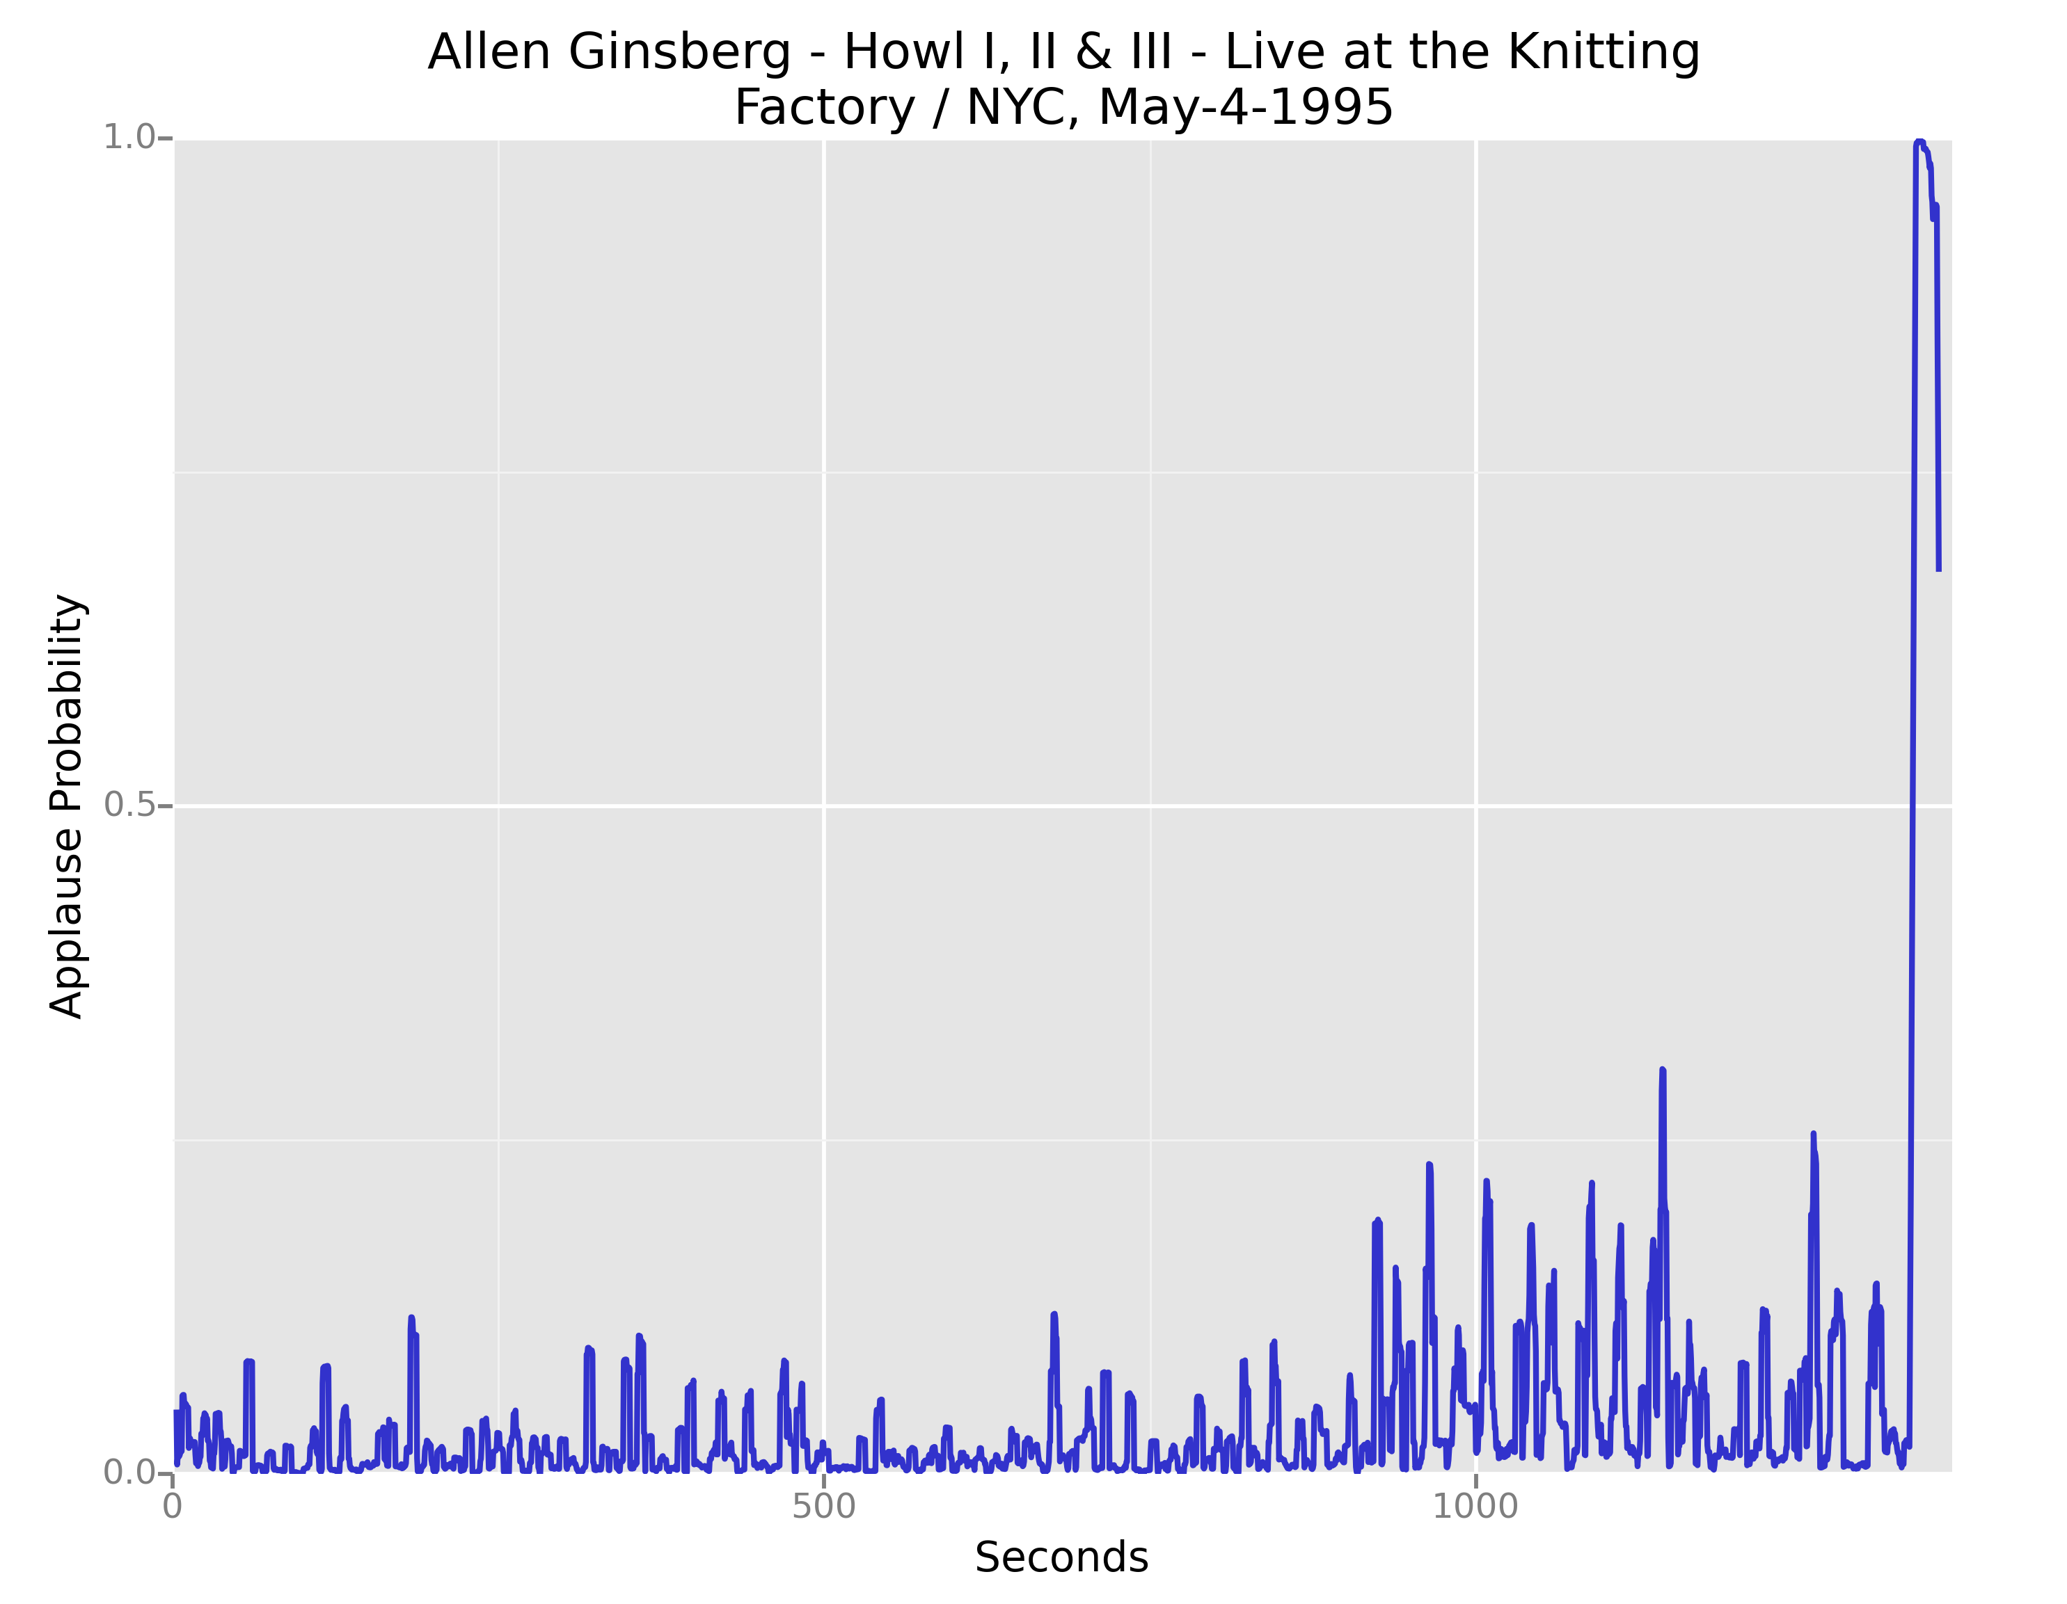
Applause in PennSound
Very Long Applause

Slide 2
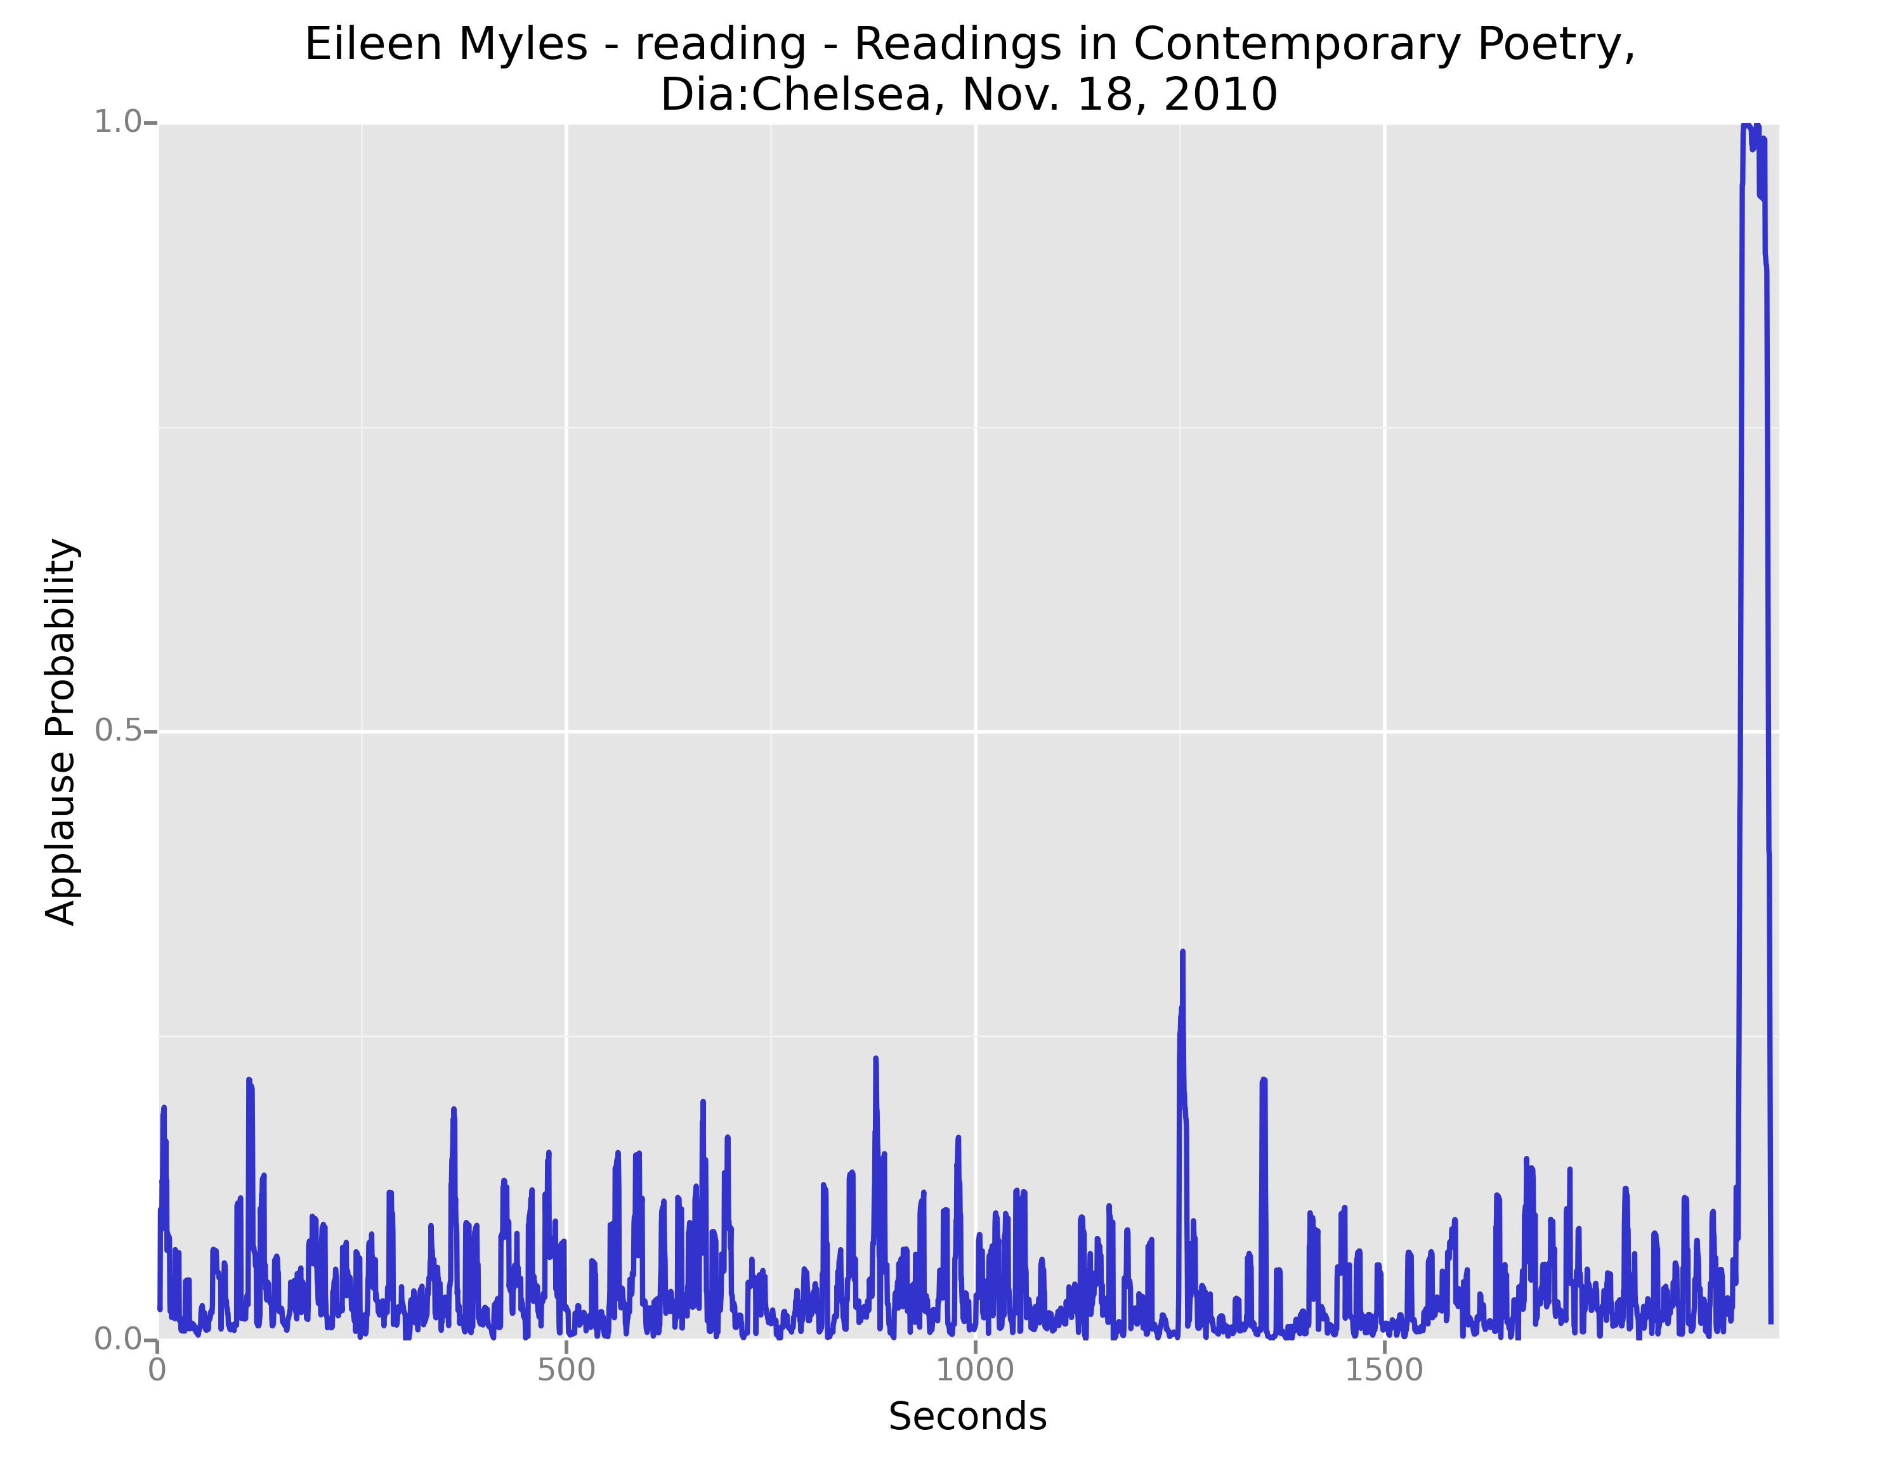
Applause in PennSound
Very Long Applause

Slide 3
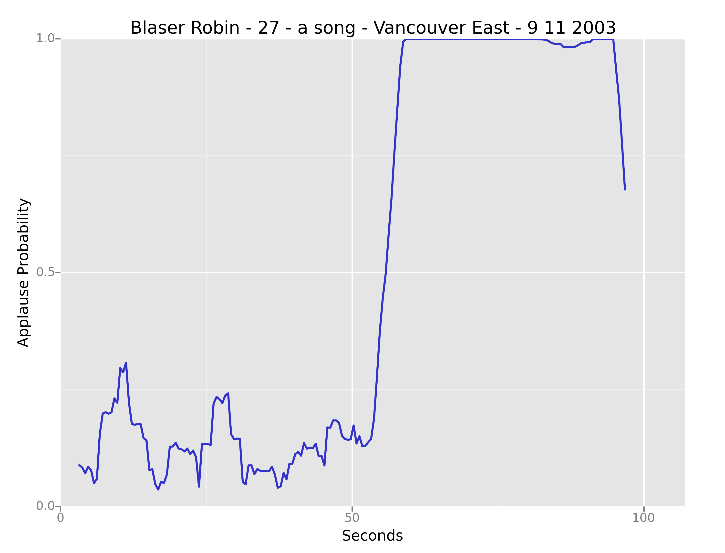
Applause in PennSound
Very Long Applause

Slide 4
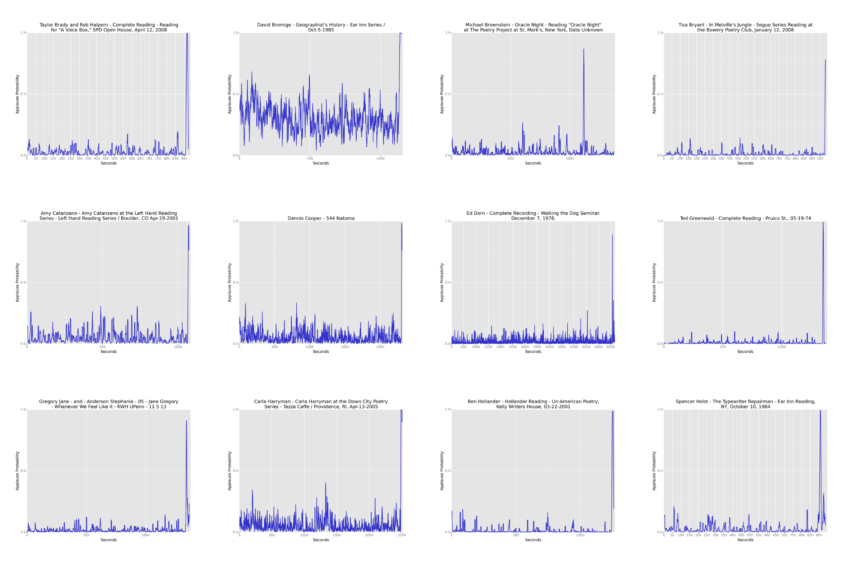
Applause in PennSound
Picture of time slices

Slide 5
Why Applause in PennSound?
Applause as delimiter between introduction and start of reading.
Who is introducing?

Slide 6
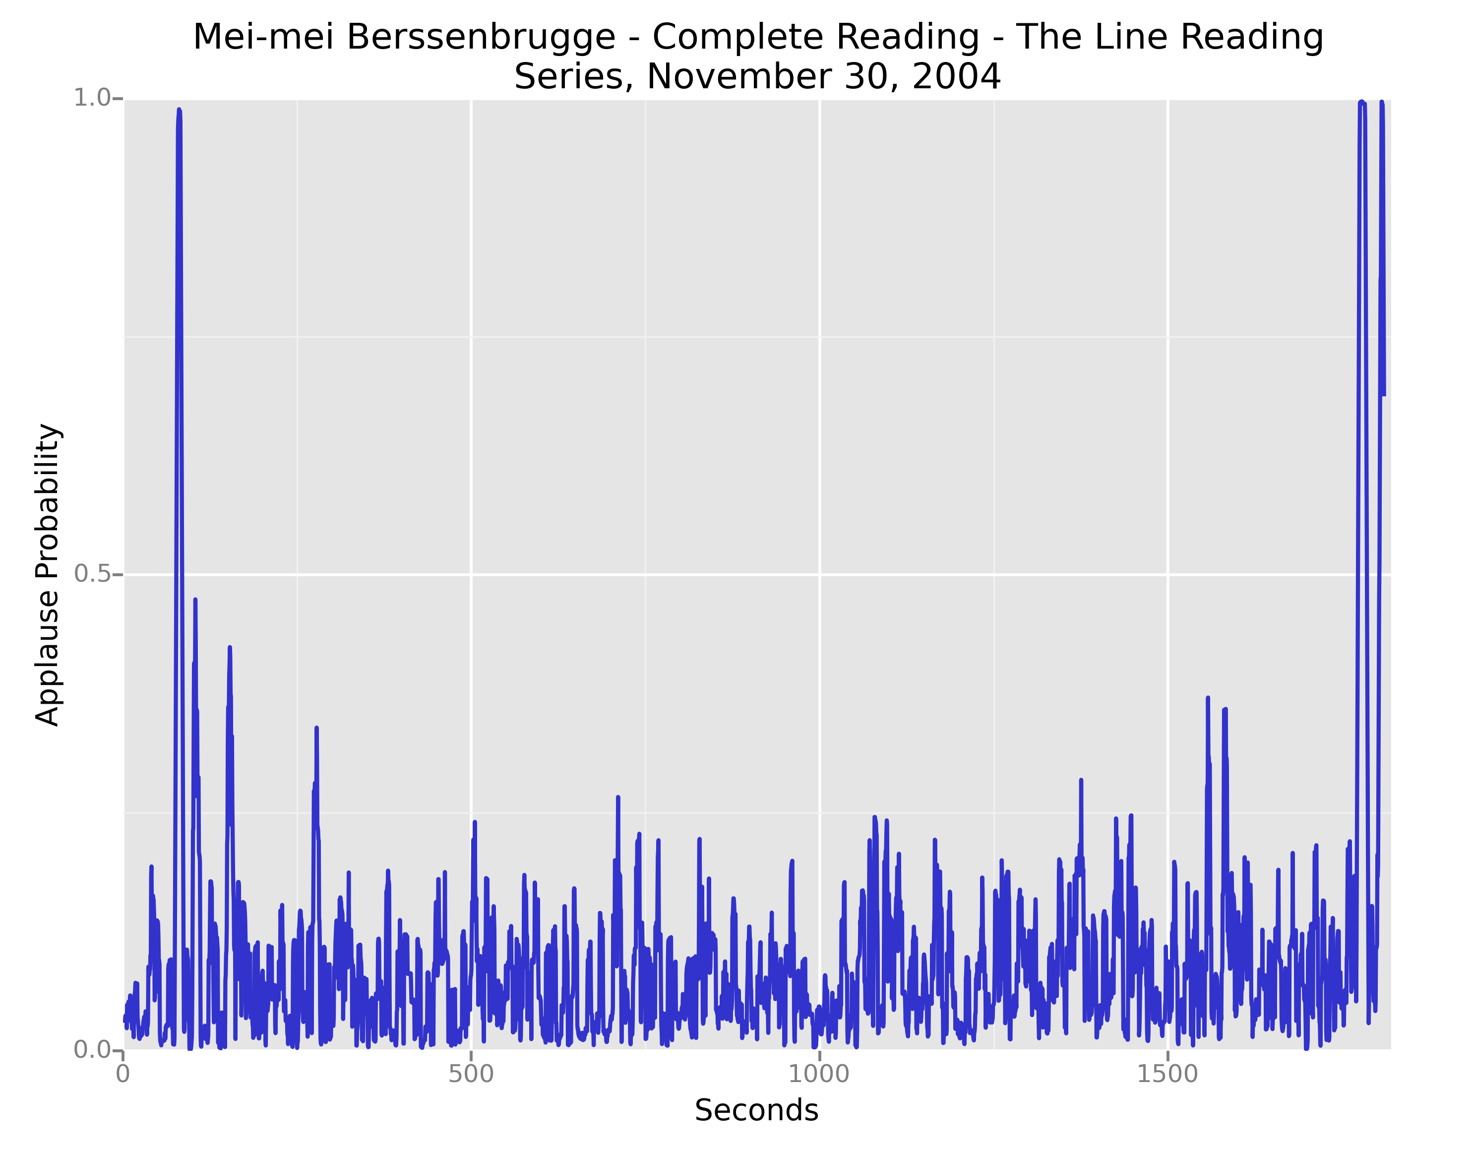
Applause in PennSound
Picture of time slices

Slide 7
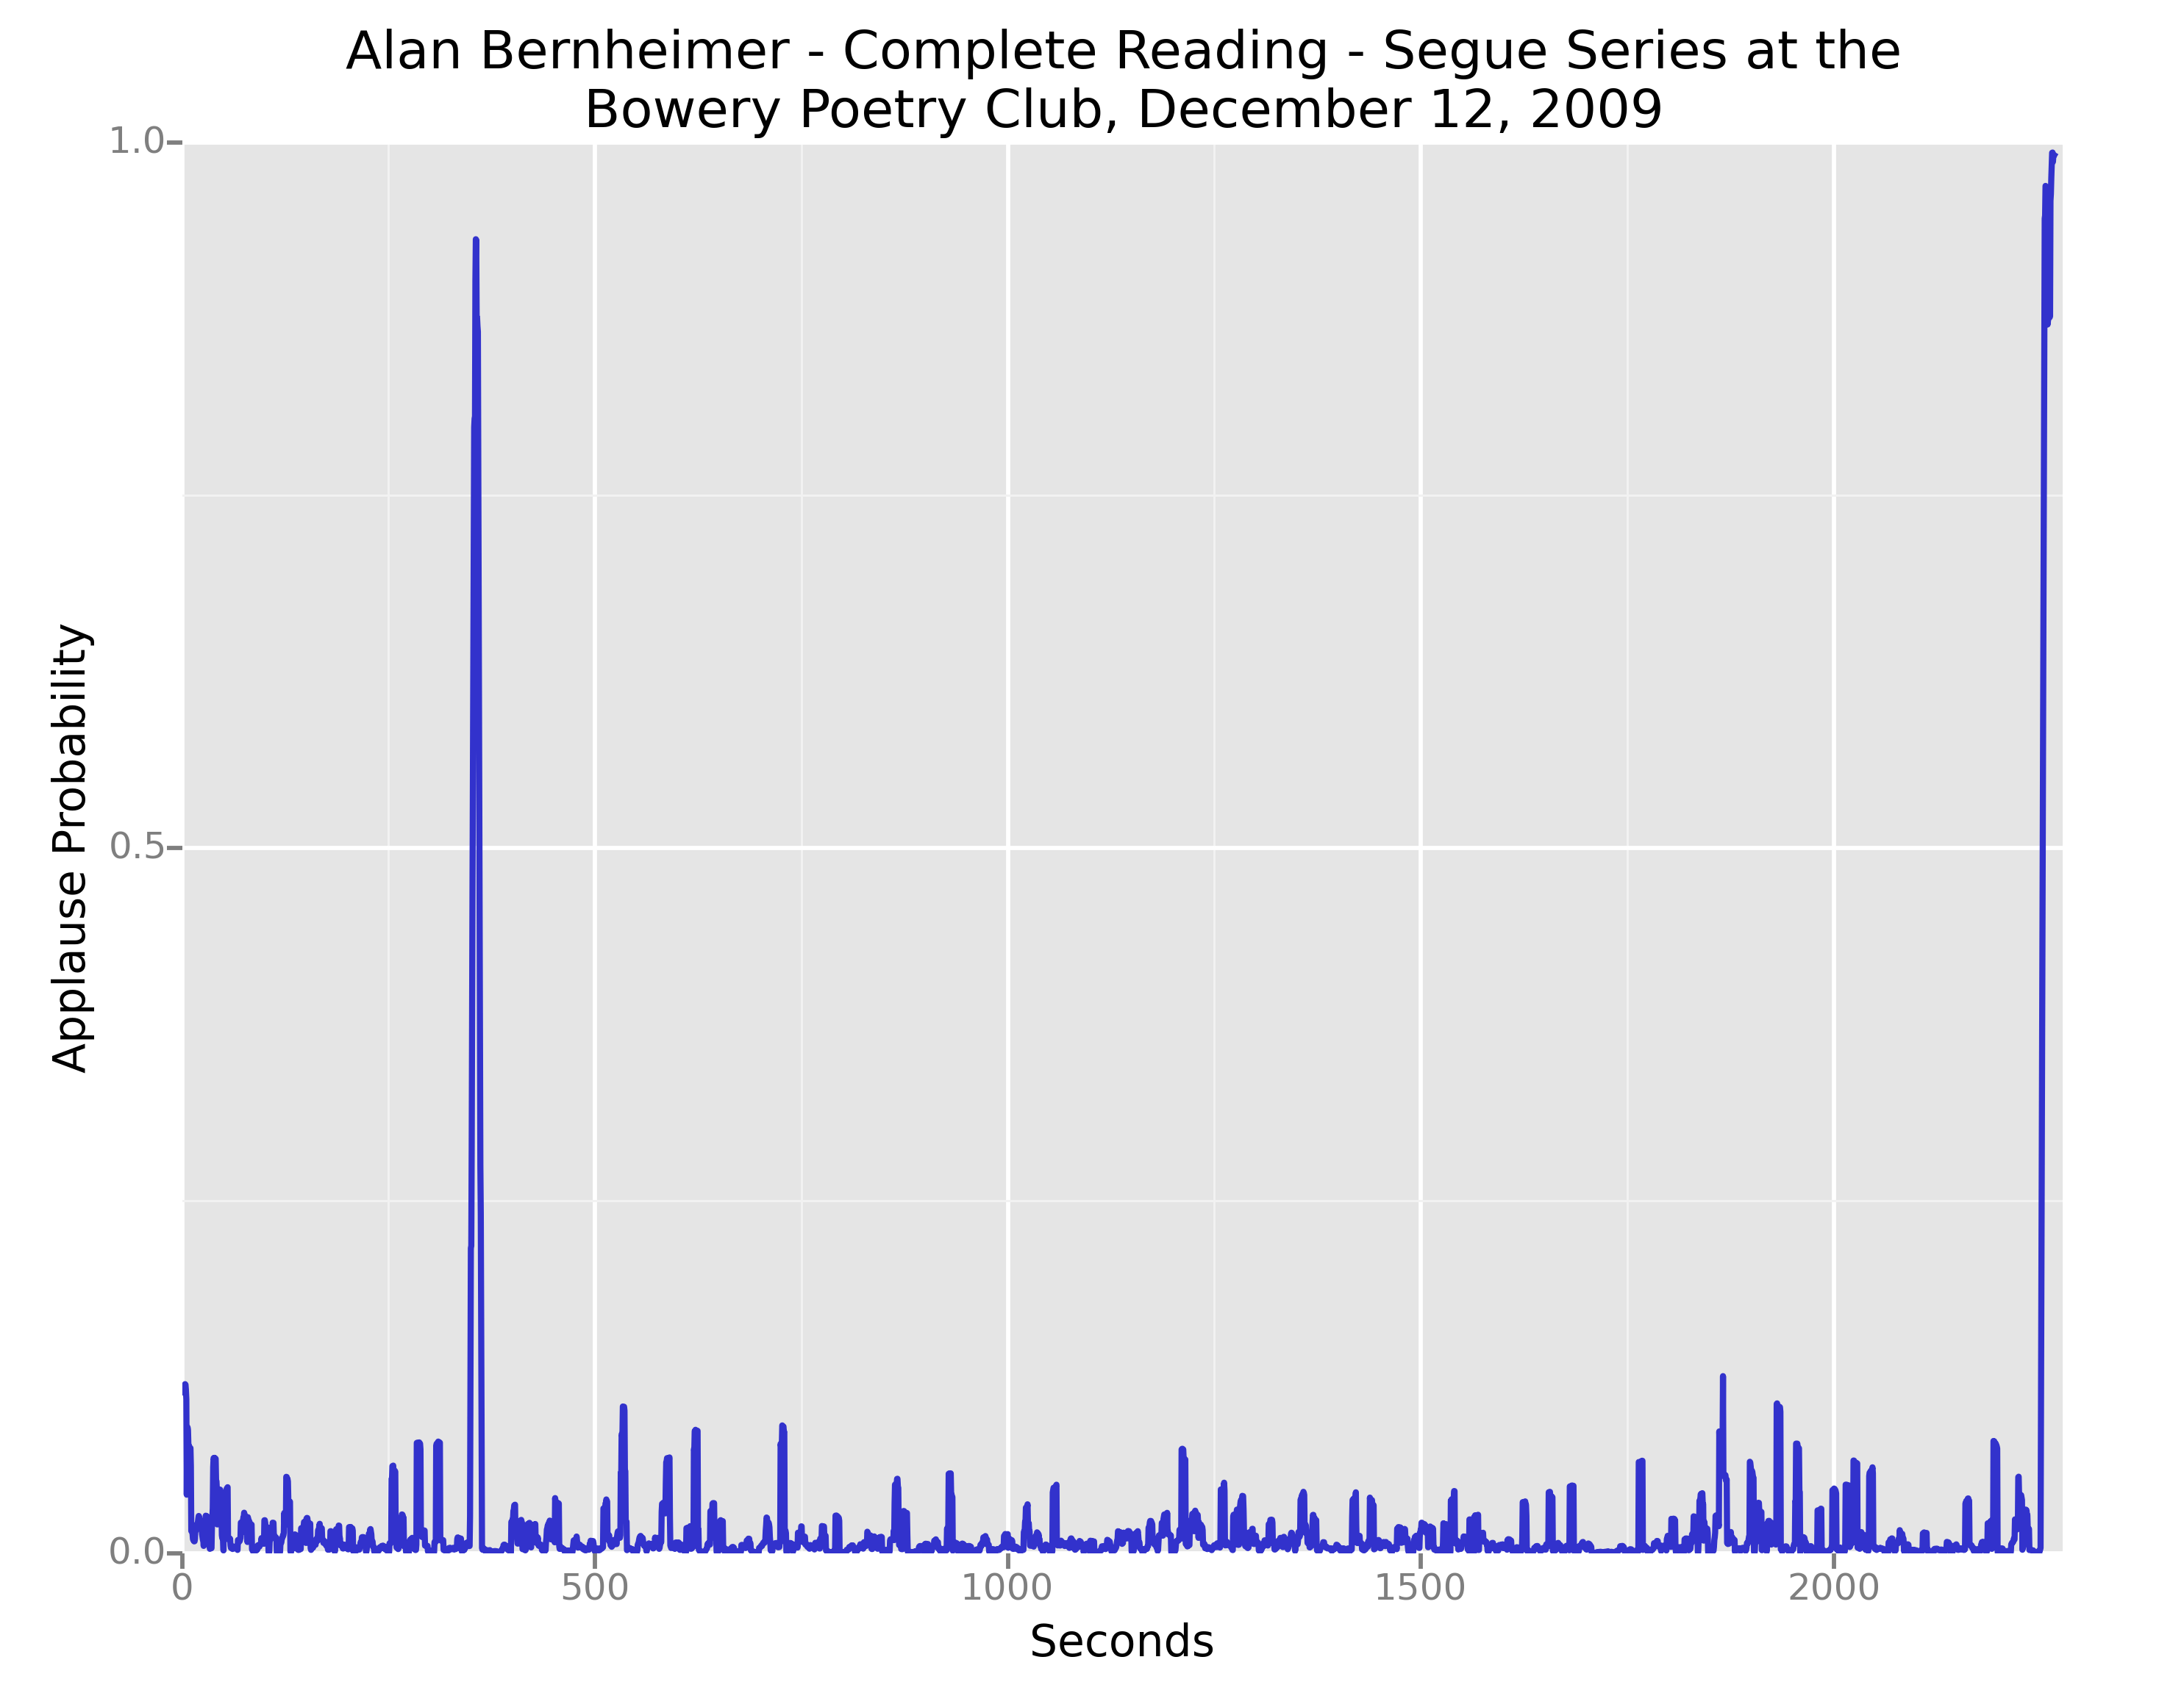
Applause in PennSound
Very Long Applause

Slide 8
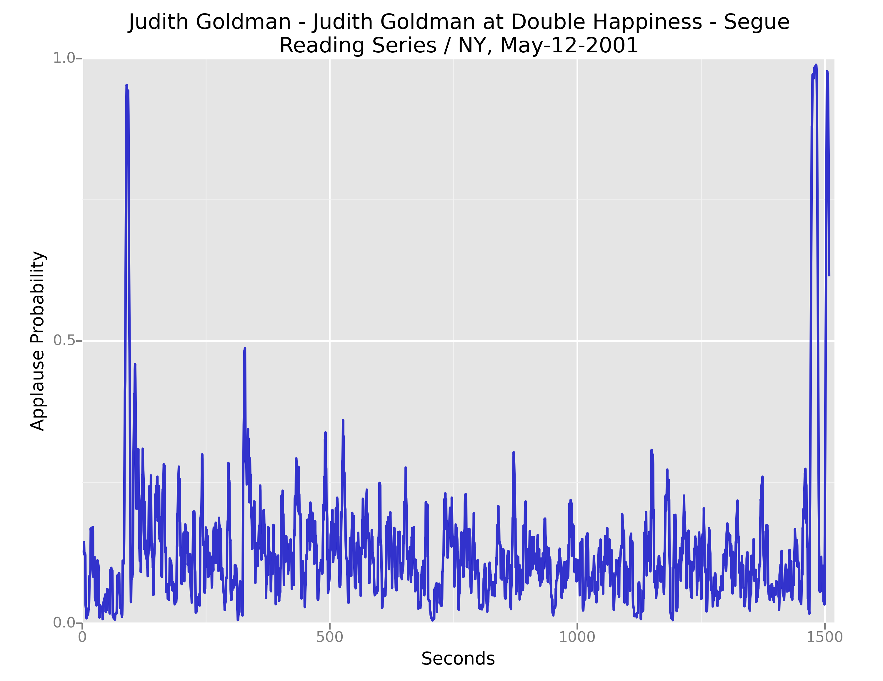
Applause in PennSound
Picture of time slices

Slide 9
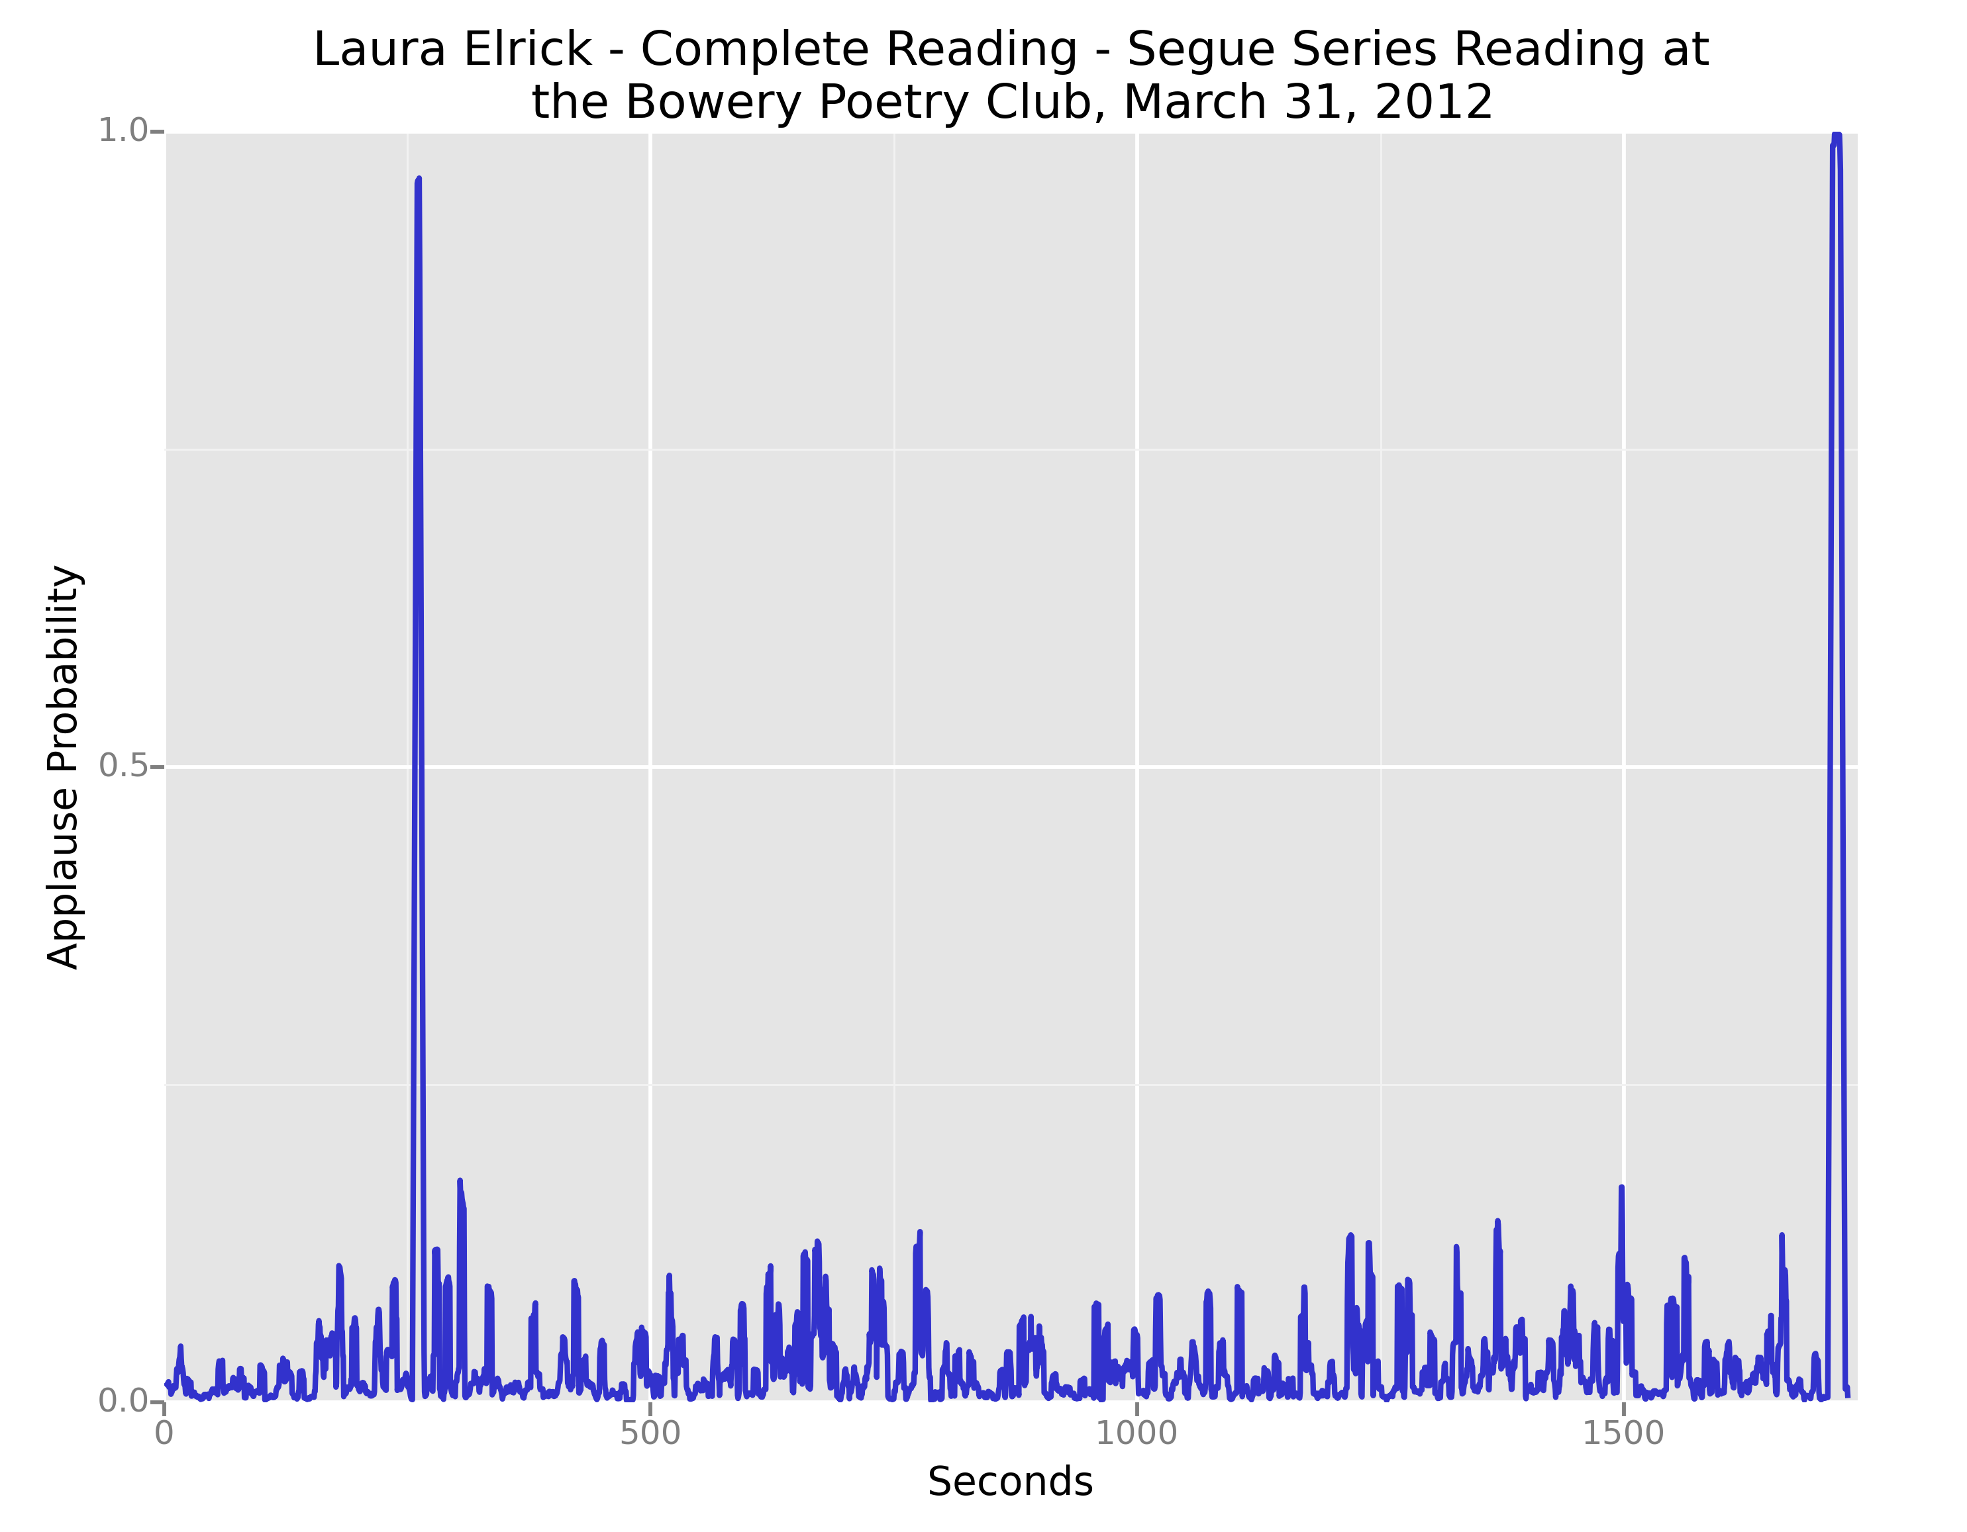
Applause in PennSound
Picture of time slices

Slide 10
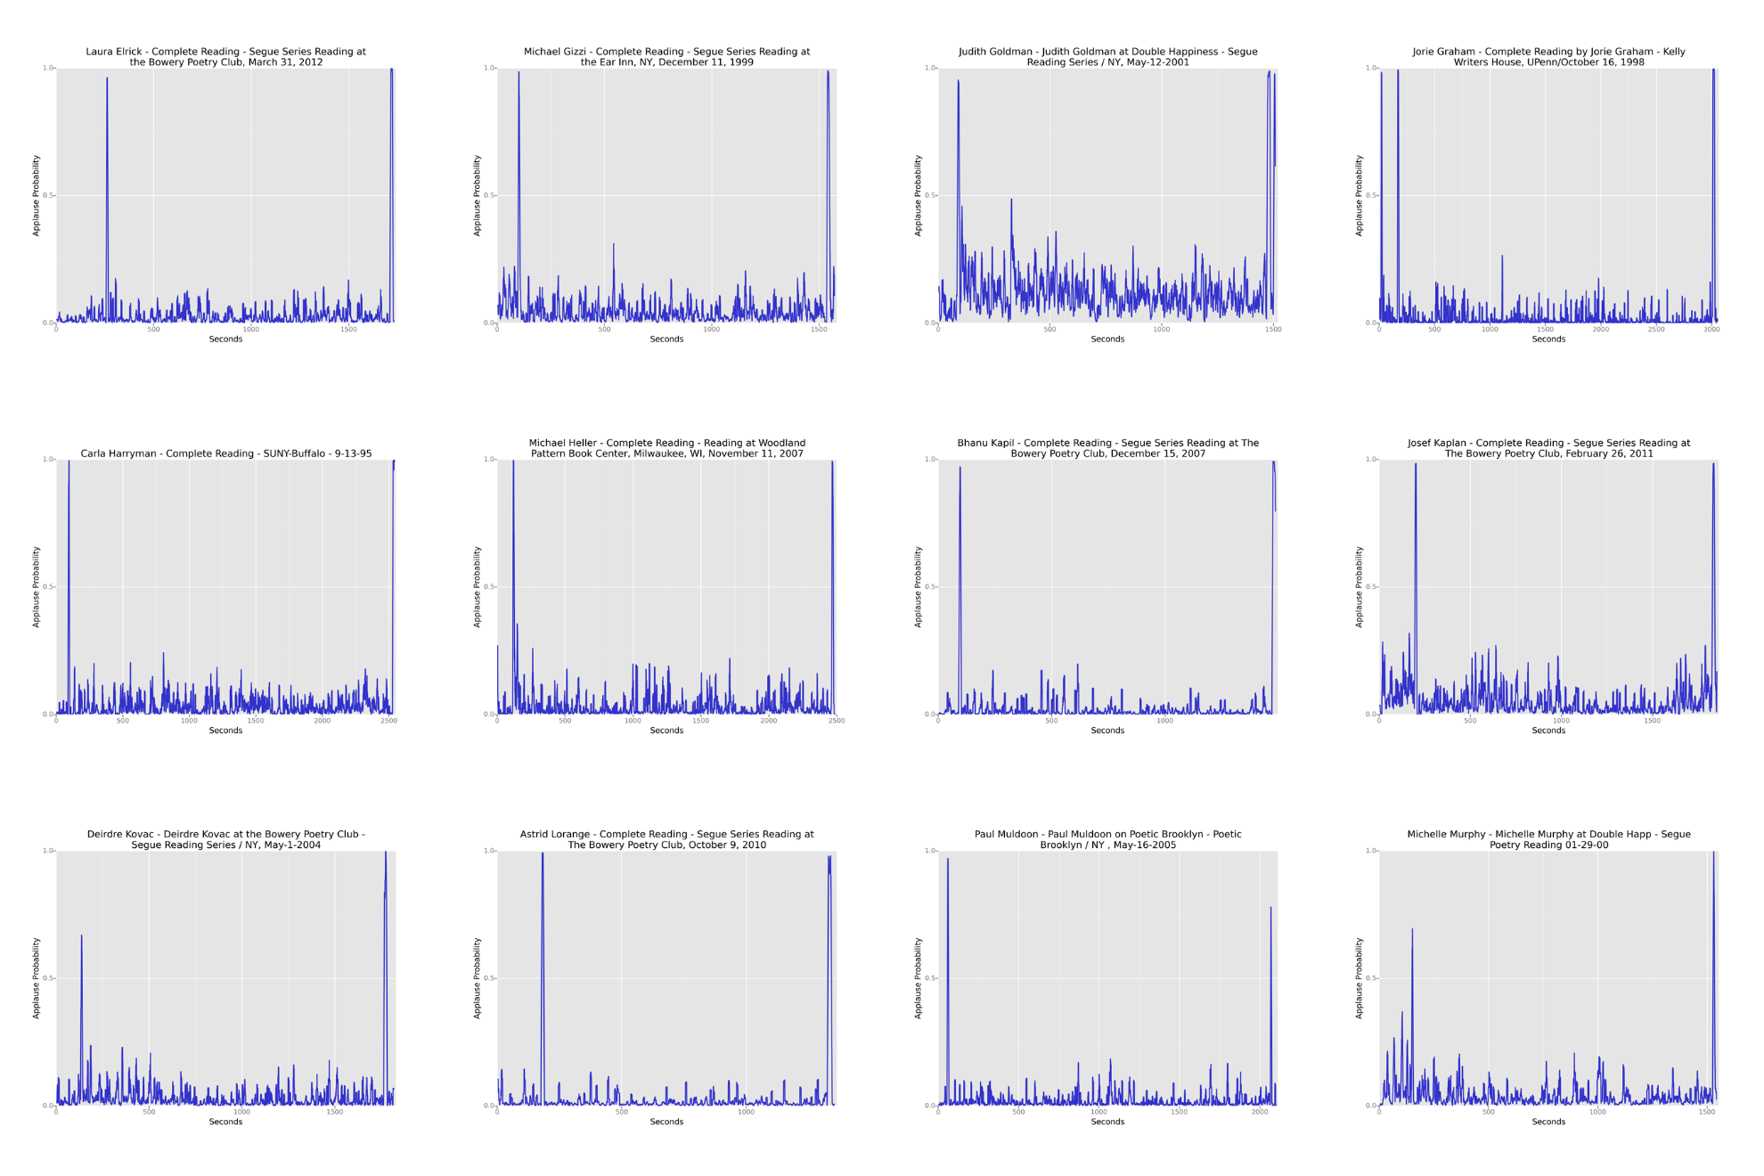
Applause in PennSound
Picture of time slices

Slide 11
Why Applause in PennSound?
For single performances, applause as delimiter between readers
Which poems get longer applause?

Slide 12
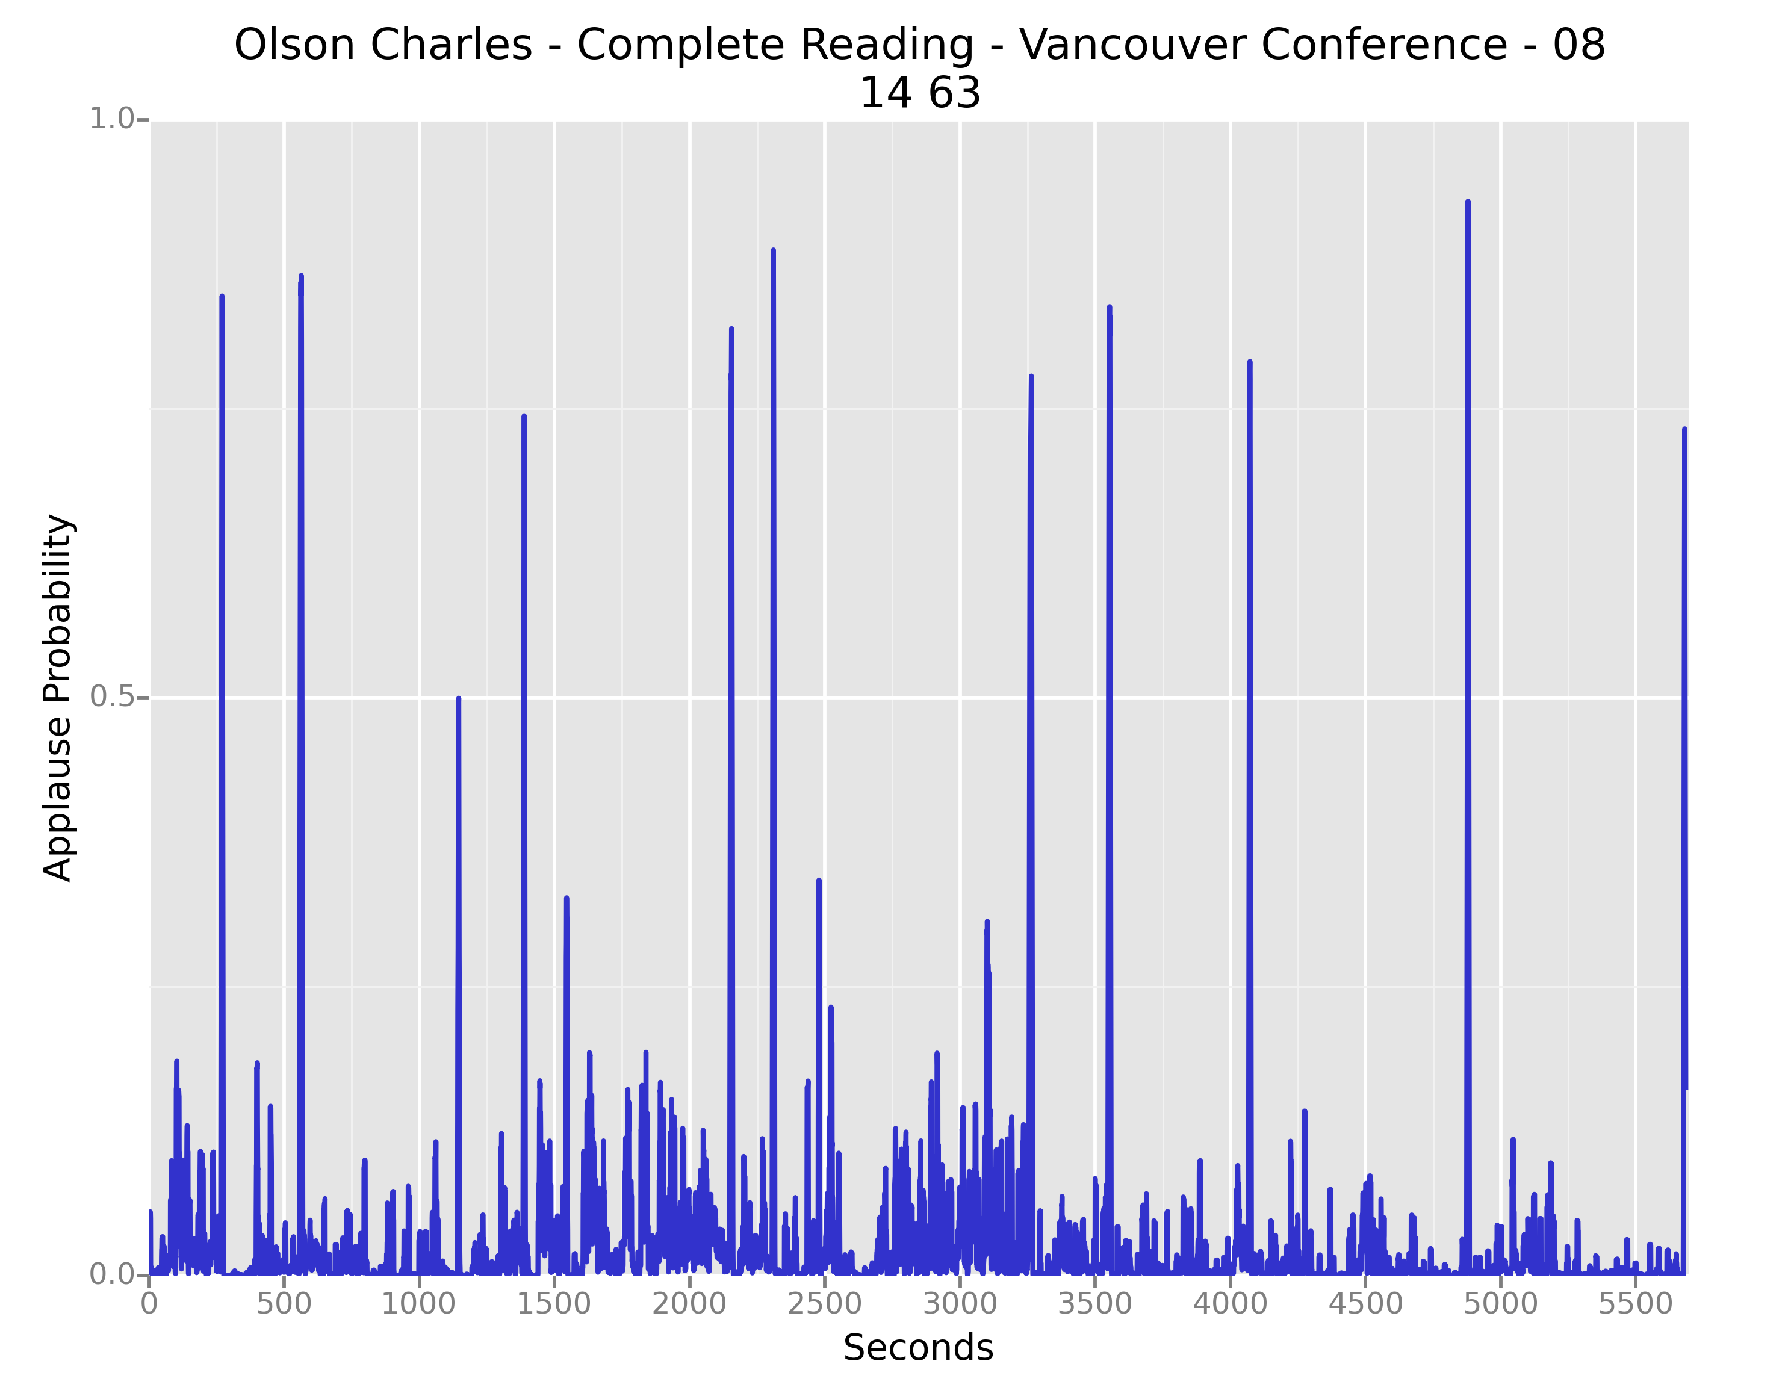
Why Applause in PennSound?
Newly observed structure: climax applause 2/3 of the way through many readings (or 1/2, or thereabouts)

Slide 13
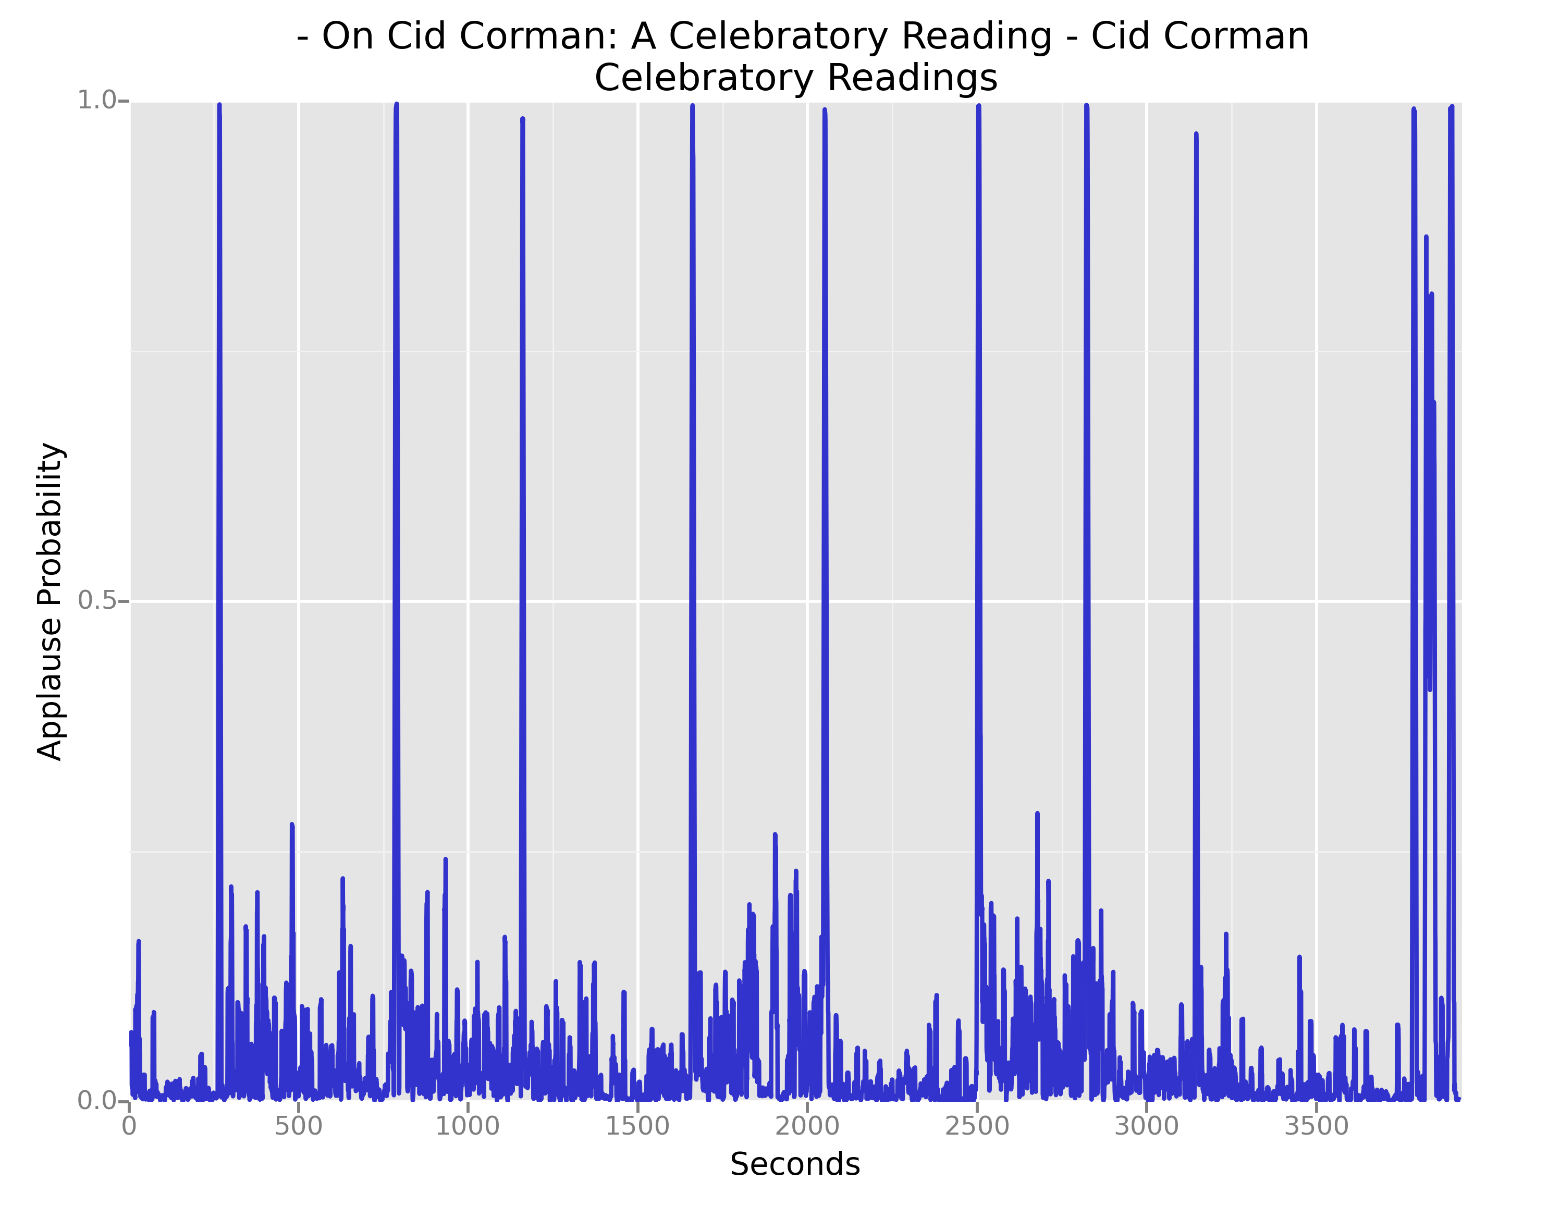
Applause in PennSound
Picture of time slices

Slide 14
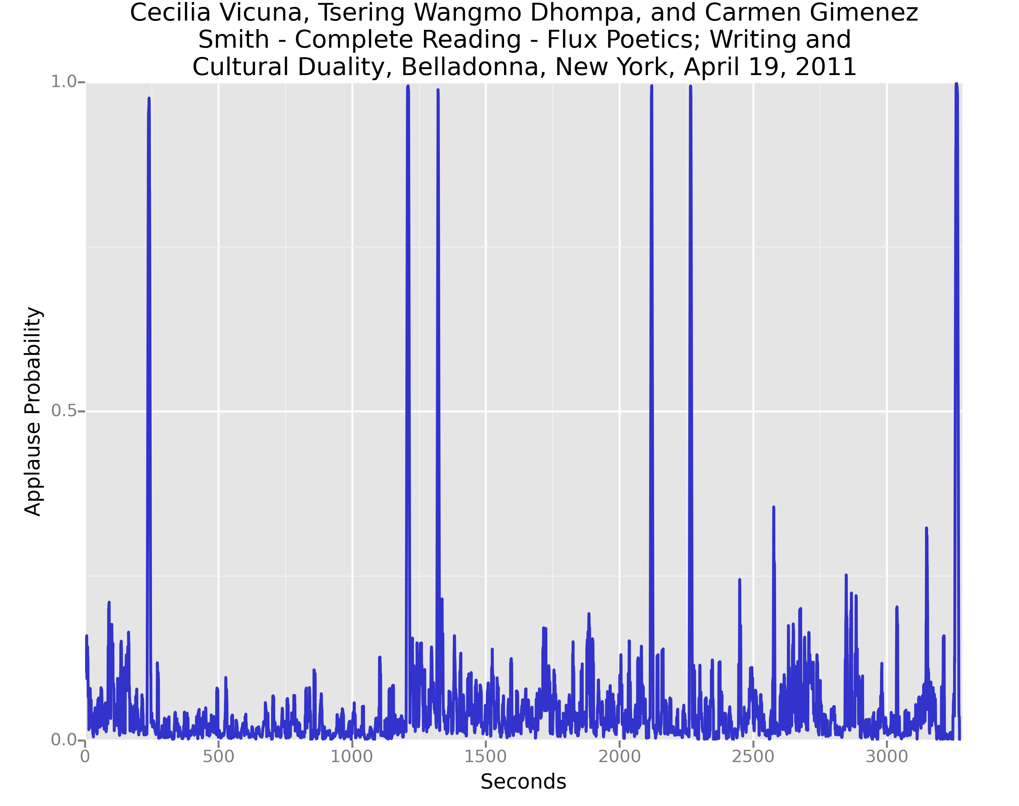
Applause in PennSound
Picture of time slices

Slide 15
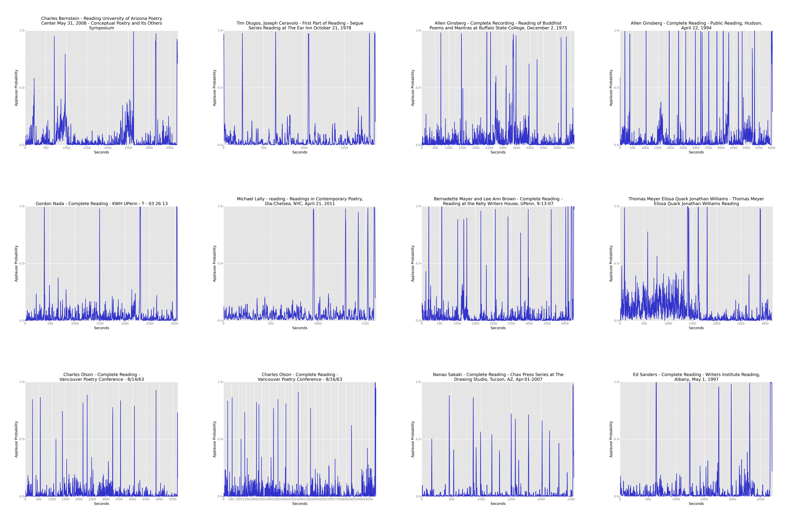
Applause in PennSound
Picture of time slices

Slide 16
Why Applause in PennSound?
For group readings, applause as delimiter between readers
Who gets longer applause?

Slide 17
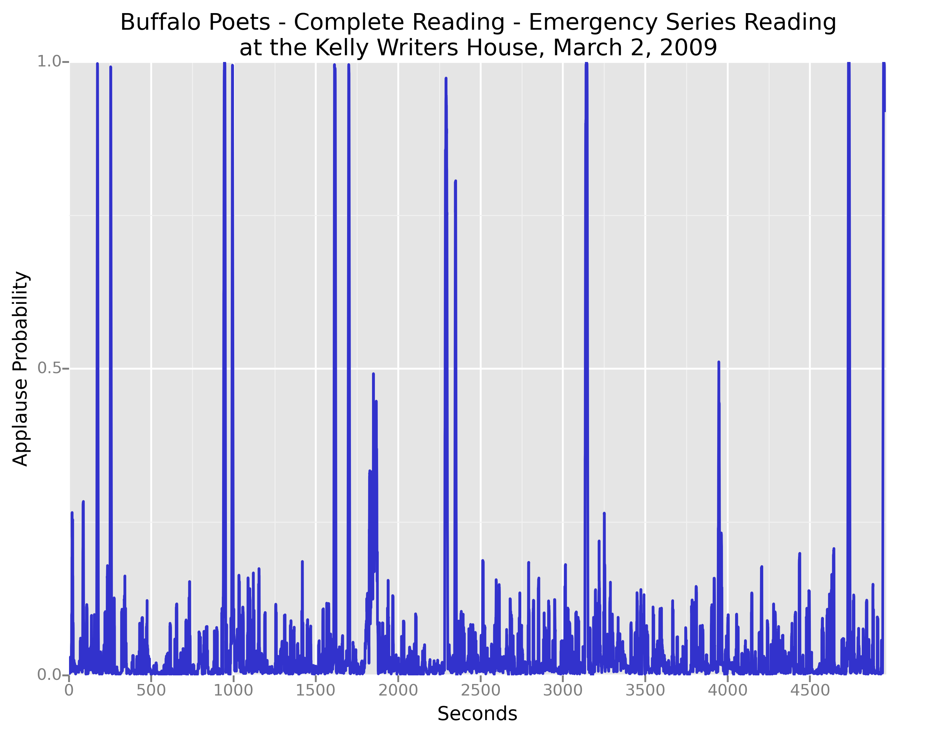
Applause in PennSound
Picture of time slices

Slide 18
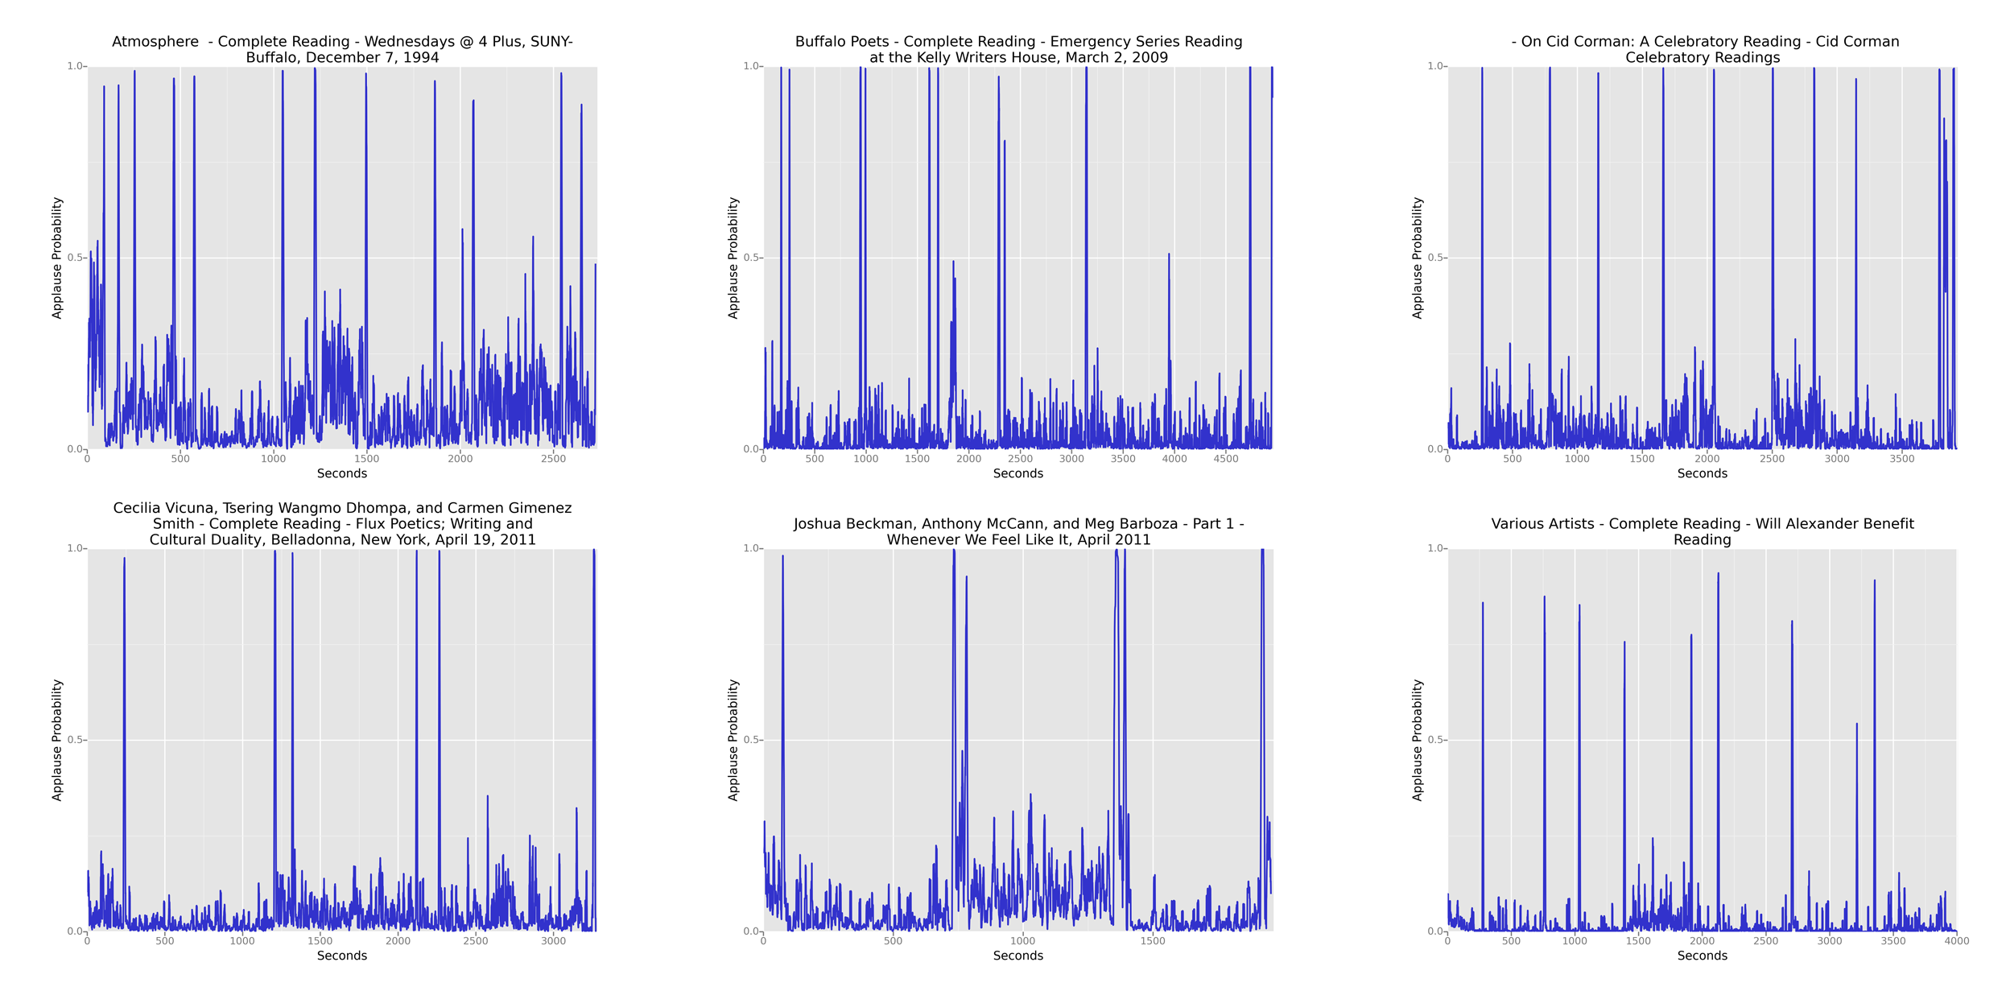
Picture of time slices

Slide 19
Why Applause in PennSound?
Newly observed structures?
Climax applause 2/3 of the way through many readings (or 1/2, or thereabouts) ?

Slide 20
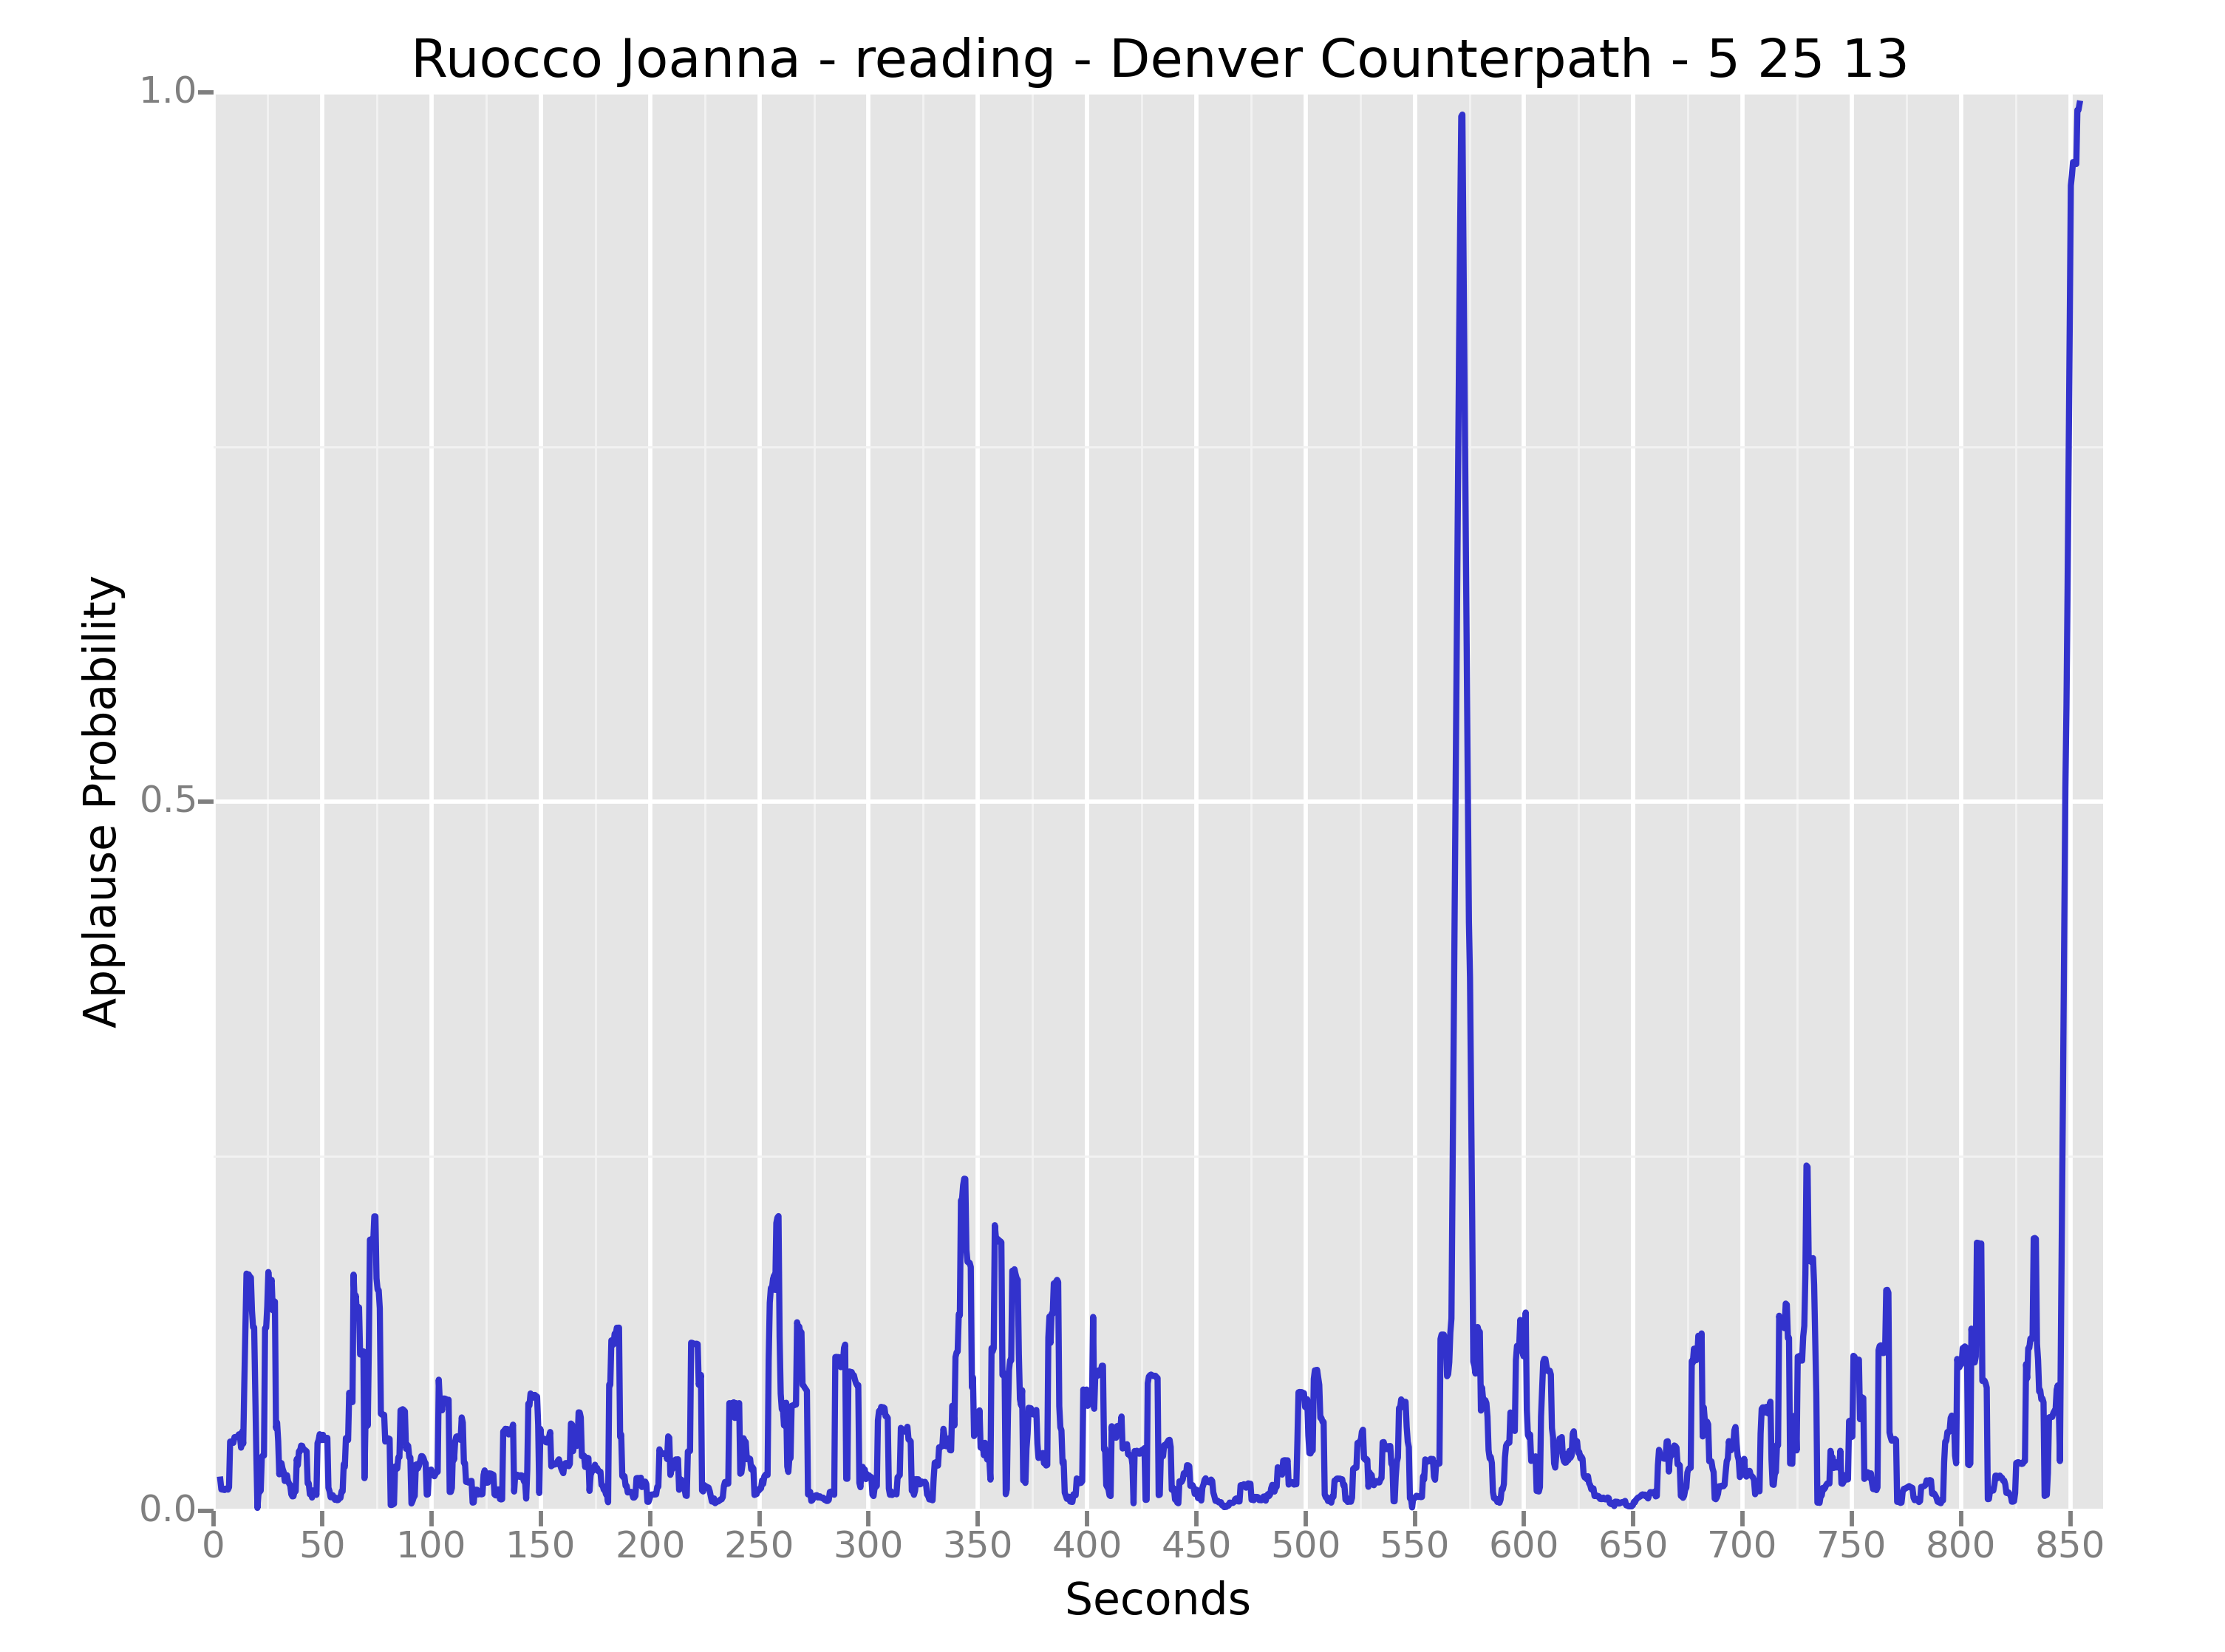
Applause in PennSound
Picture of time slices

Slide 21
Why Applause in PennSound?
End applause before questions:
What kinds of questions do people ask? Do some poems or audiences provoke more questions?

Slide 22
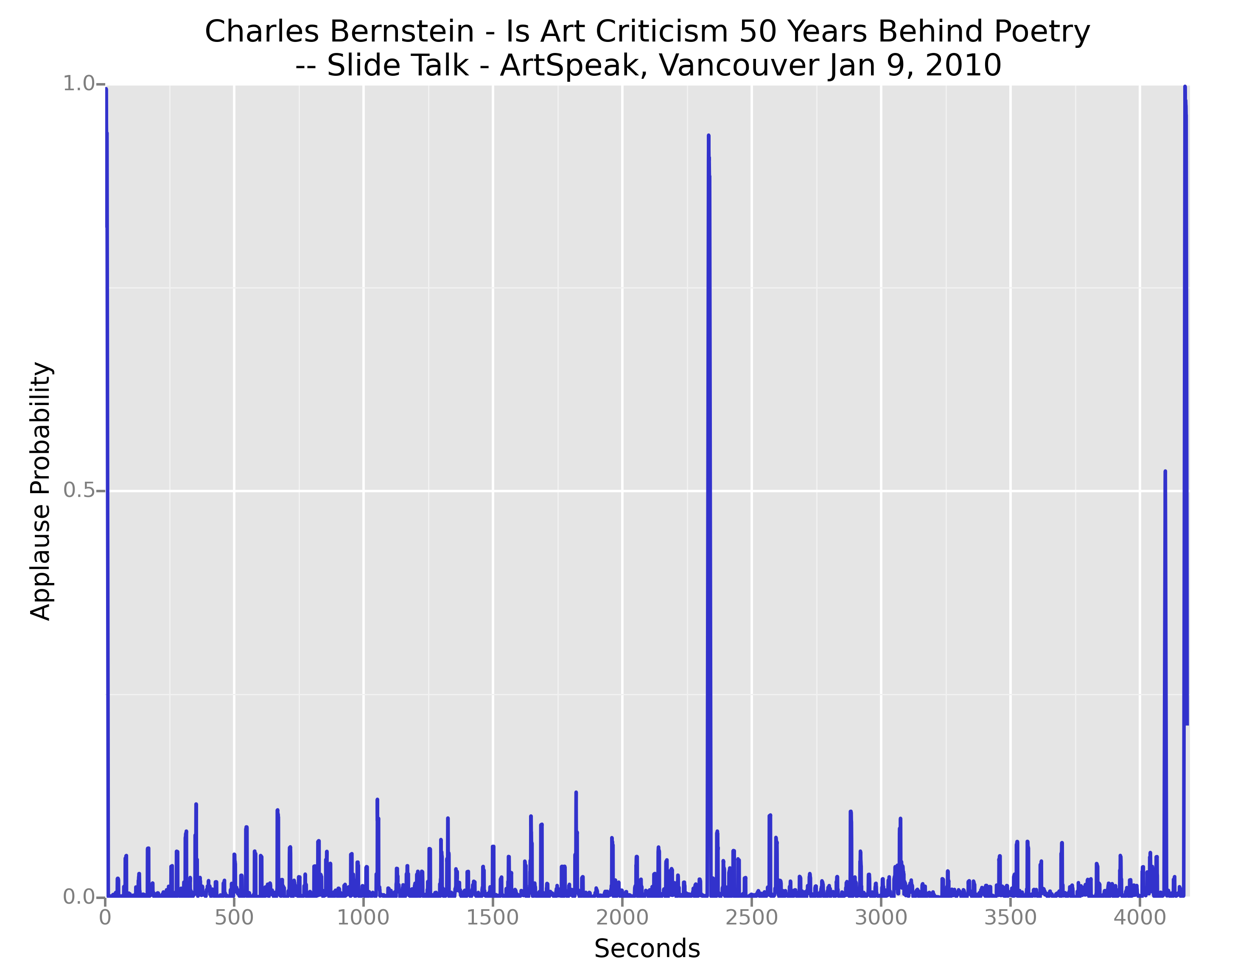
Applause in PennSound
Picture of time slices

Slide 23
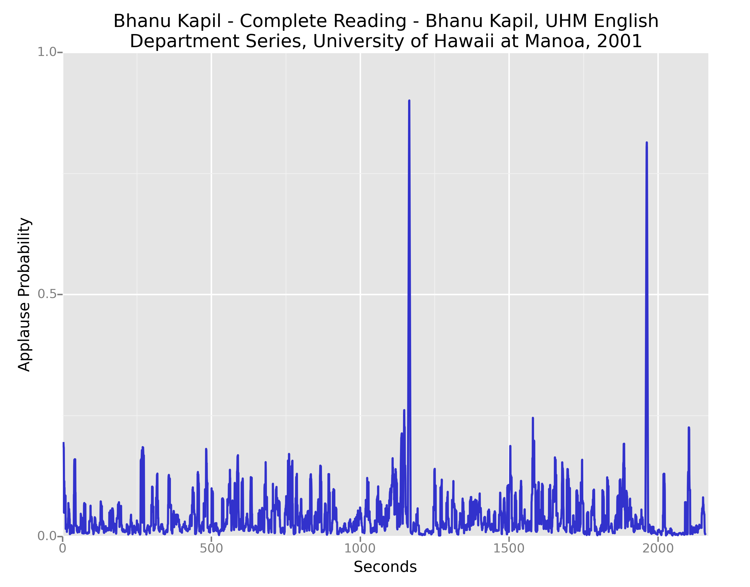
Applause in PennSound
Picture of time slices

Slide 24
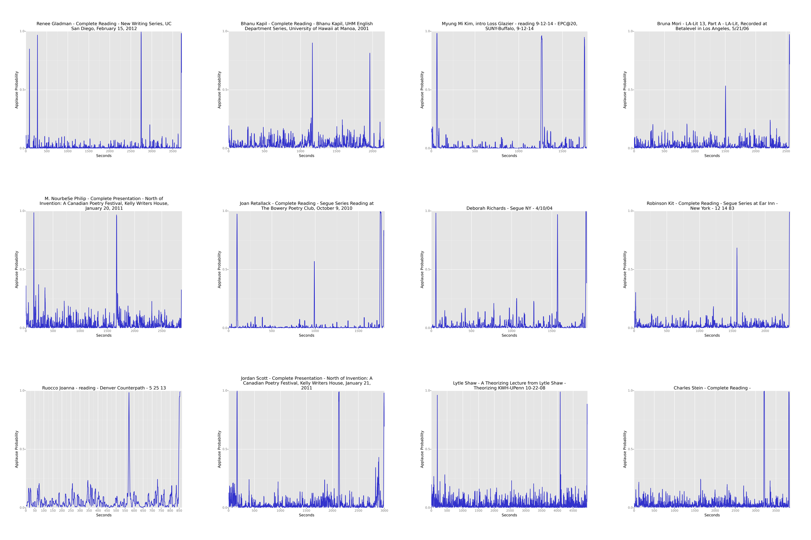
Applause in PennSound
Picture of time slices

Slide 25
Wait!
Are there mistakes?

Slide 26
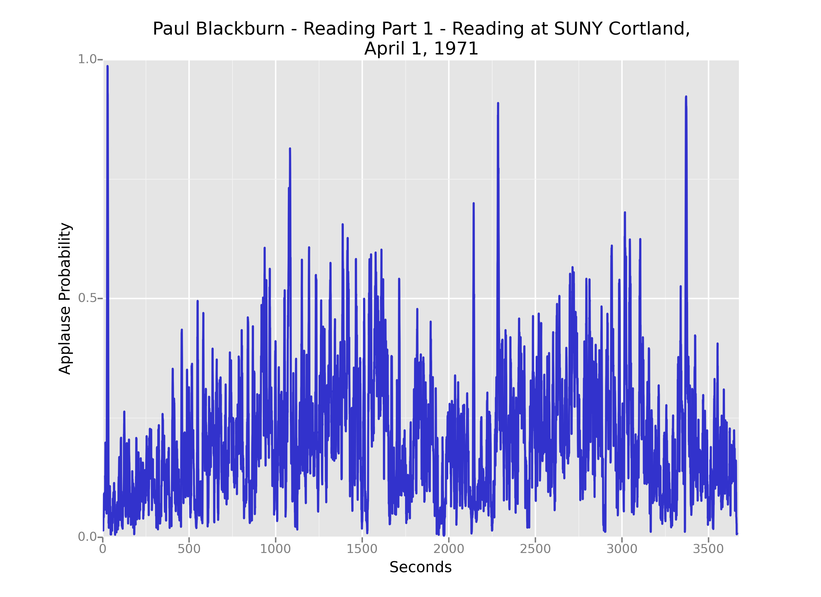
Applause in PennSound
Picture of time slices
False ID: strong hiss

Slide 27
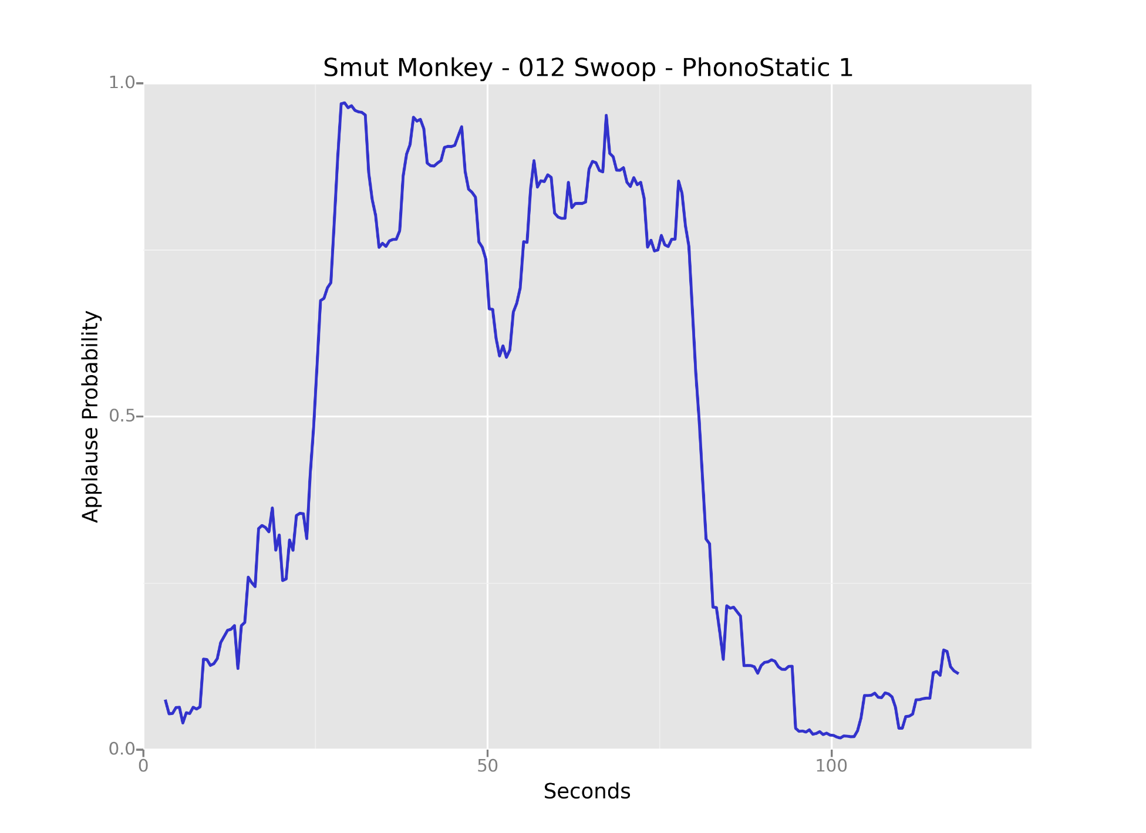
Applause in PennSound
Picture of time slices
False ID: ­ Dissonant music

Slide 28
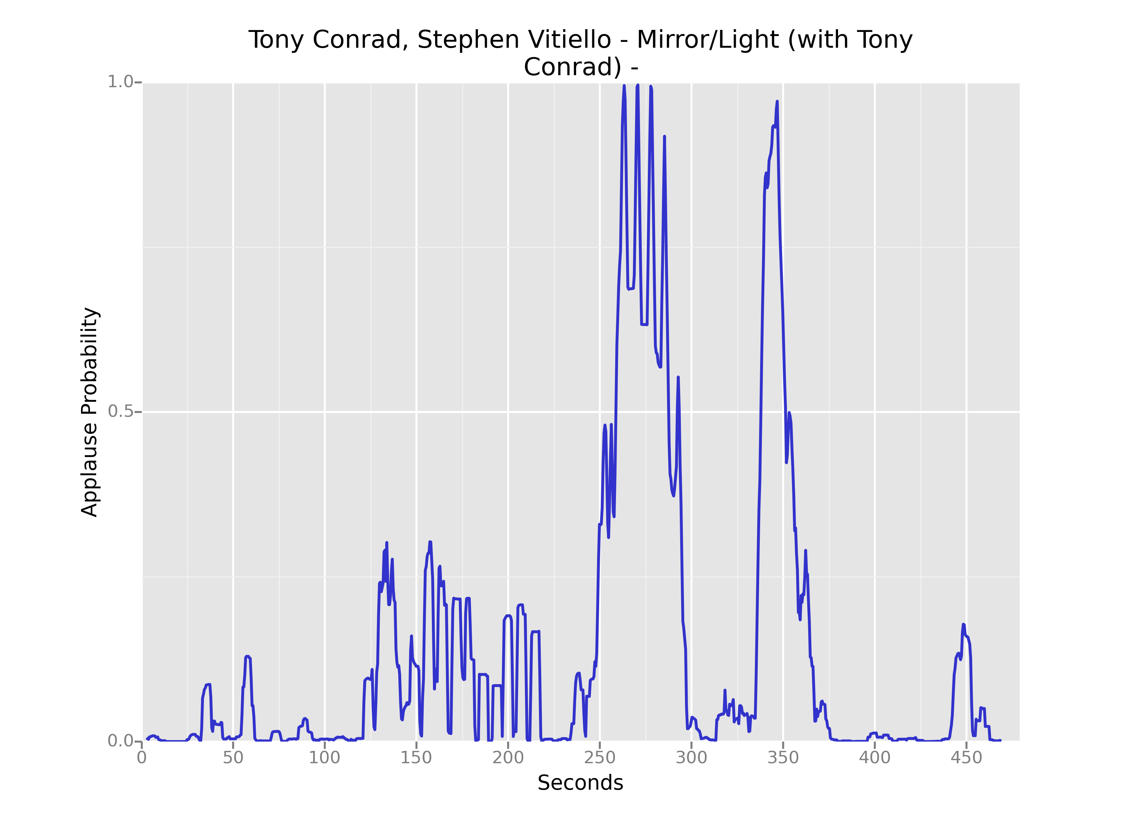
Applause in PennSound
Picture of time slices
False ID: ­ Dissonant music

Slide 29
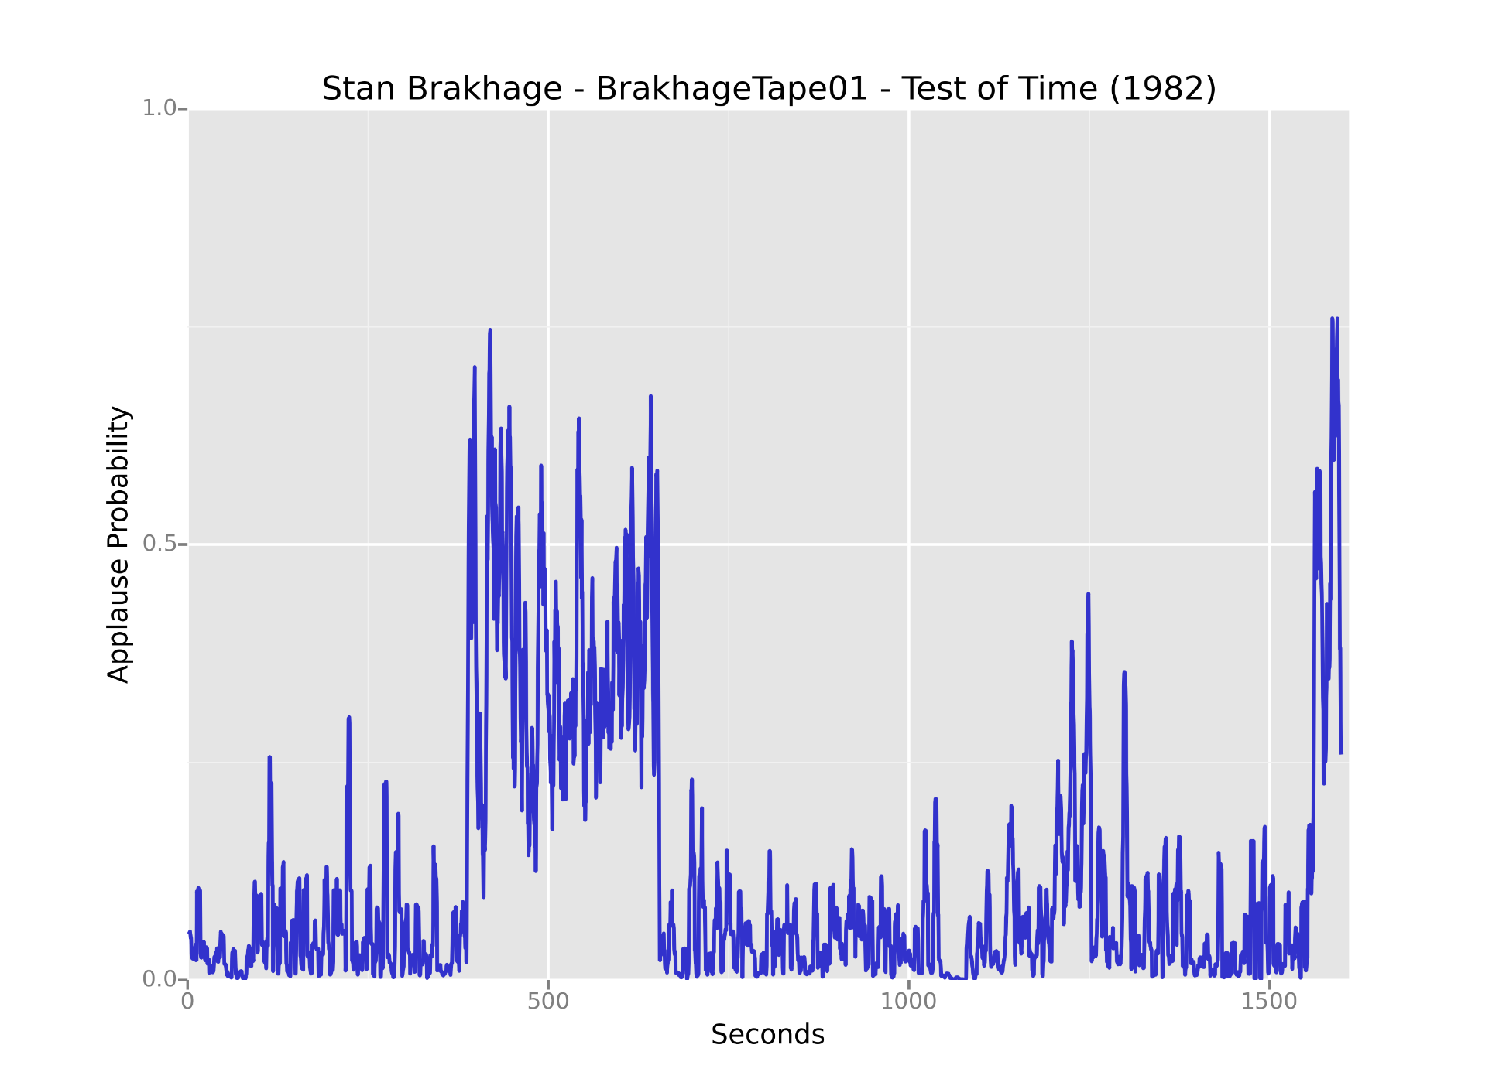
Applause in PennSound
Picture of time slices
False ID: ­ Bagpipe

Slide 30
What we thought might be interesting to know:
Do poets get longer applause if they are men or women?
Are their differences based on the decade?
Is applause length regional or venue specific?

Slide 31
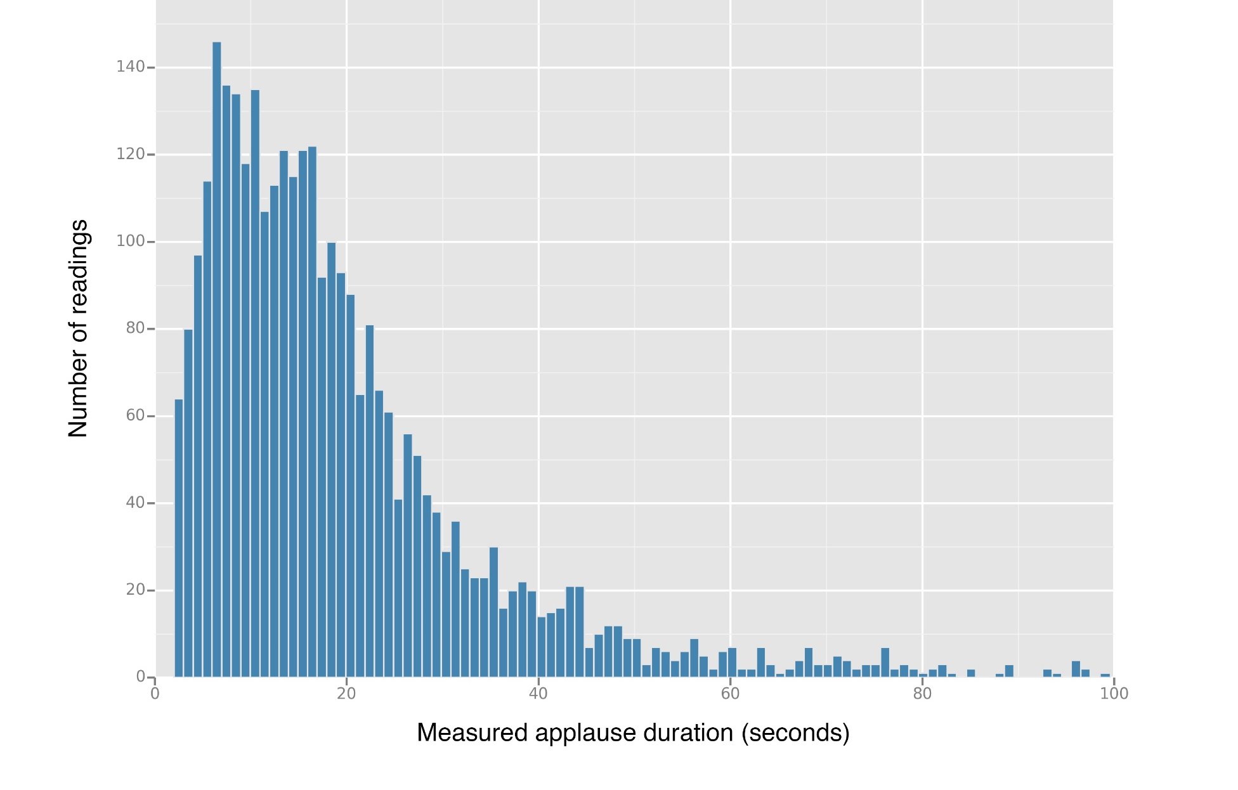
Histogram of Measured Applause Durations for 3,130 Poetry Readings, Binned at 1-Second Level

Slide 32
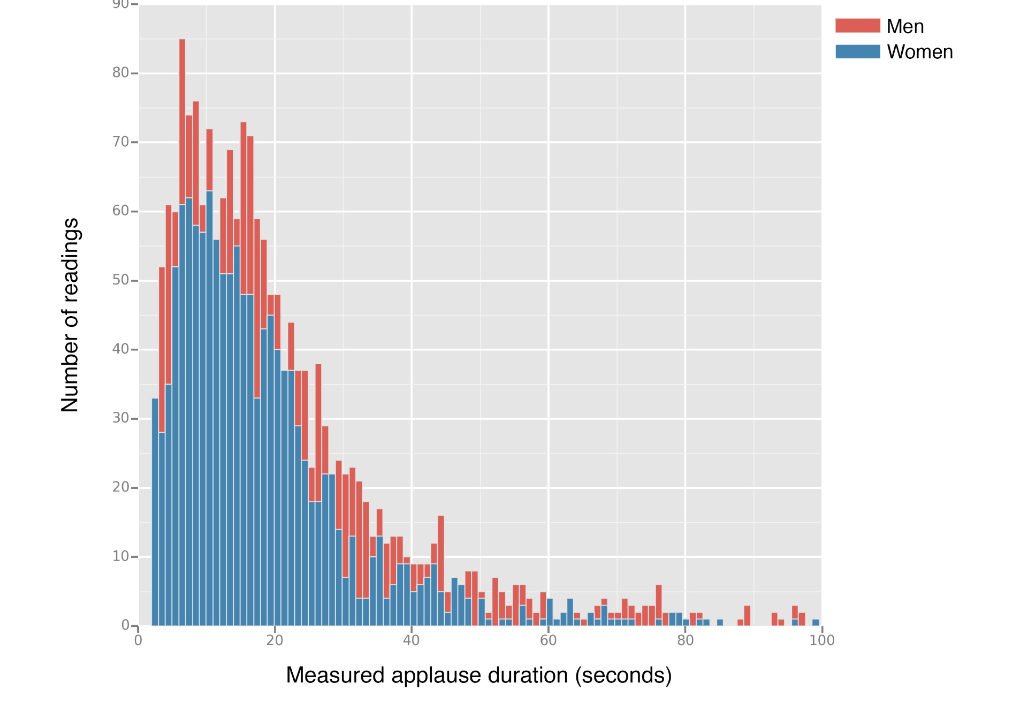
Overlaid Histograms of Measured Applause Duration by Gender for 3,114 Poetry Readings, Binned at 1-Second Level

Slide 33
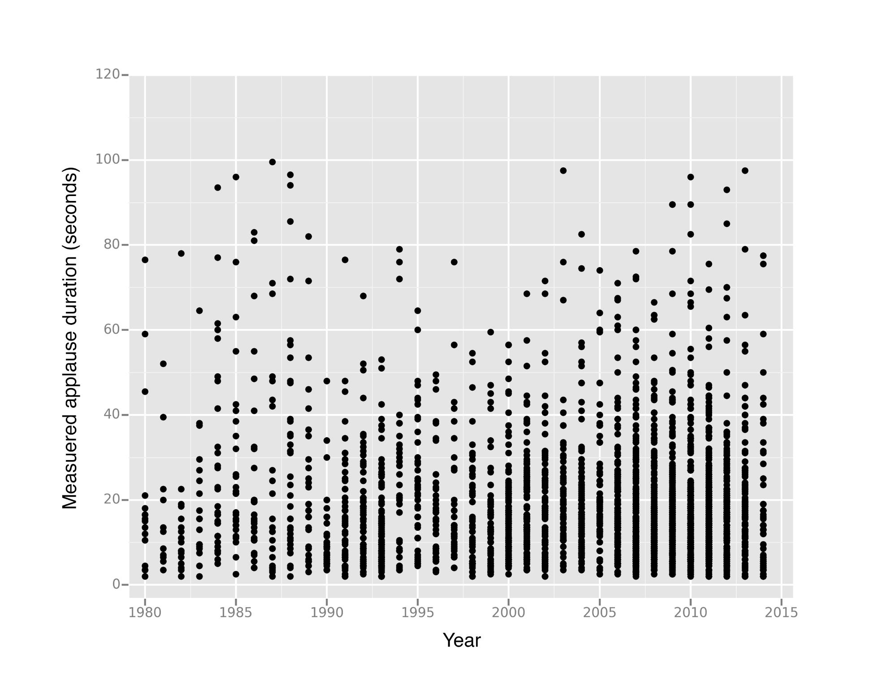
Plot of Measured Applause Durations by Year for 2,870 readings between 1980 and 2014

Slide 34
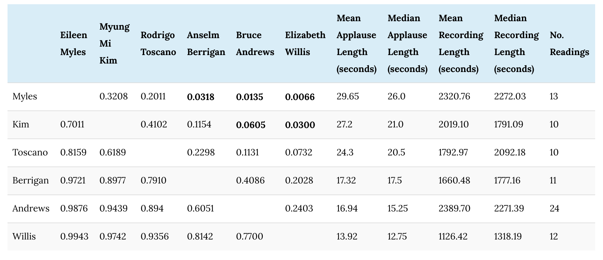
P values for Pairwise Directional Mann-Whitney U Tests Between Six Poets' Measured Applause Durations
Notes:
While scholars have examined the underrepresentation of women across poetry publications, 10 there do not appear to be major differences in the rate of applause by gender in our sample of PennSound.

Slide 35
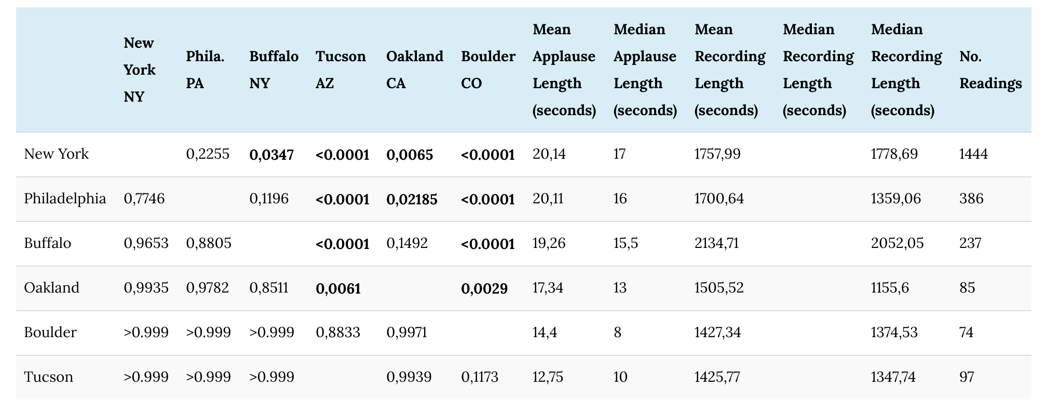
P values for Pairwise Directional Mann-Whitney U Tests Between Six Cities' Measured Applause Durations (Seconds)
Notes:
We do see differences when comparing cities, which perhaps show evidence of regional variation in communication conventions

Slide 36
But are these good questions for cultural analysis?
Do poets get more applause if they are men or women?
Are their differences based on the decade?
Is applause regional or venue specific?

Slide 37
Problems
Venue: very different readings can occur at similar venues
Readers: may present differently for different occasions
Audience: may react differently at different times in the same venue with the same poet
And, what culture? Looking at a single venue or speaker may not give a consistent picture of the audience dynamics at play at a particular venue or with a particular poet

Slide 38
So, why are performances interesting to scholars?
Charles Bernstein refers to literary performance as "both stress test, in which the rhythms are worked out in real time, and trial of the poet's ability to engage listeners” (Bernstein, 2011).
Paul Zumthor refers to each audience member as "the coauthor" of a performance (Oral Poetry: An Introduction, 1990).
Peter Middleton describes the relationship between audience and poet as a collaboration which "creates an intersubjective network, which can then become an element in the poem itself” ("The Contemporary Poetry Reading,” 1998).

Slide 39
Reading Series: Why?
Reading Series
are communities of practice: “communities of practice” include "routines, words, tools, ways of doing things, stories, gestures, symbols, genres, actions" that mark "a history of mutual engagement” that remains "inherently ambiguous," an ambiguity that "is a condition of negotiability and thus a condition for the very possibility of meaning" (Wenger, 16).
provide an opportunity for studying cultural production across a range of different communities
Wenger, E. Communities of Practice: Learning, Meaning, and Identity. Cambridge University Press, 1998.

Slide 40
Reading Series: Why?
Specific sites in which poets and their audiences form and maintain particular tastes, conventions, and group temperaments that inform how a poem is shaped and understood and reshaped in that culture.
Varied sites as:
serious affairs and result in academic publication; or
community gatherings for fun
sponsored by a foundation or academic department or
run on a shoestring by one or two individuals
provide a venue for early-career writers and those who may feel marginalized by the mainstream establishment or are otherwise not formally affiliated with academia
Wenger, E. Communities of Practice: Learning, Meaning, and Identity. Cambridge University Press, 1998.

Slide 41
Applause and reading series
For this study, we are working from the premise that applause in reading series
serves as a discovery point for considering how a poet interacts with an audience in a particular poetry culture
Includes a measurable duration, of which the measure can represent a rough index of an audience's engagement with a given reading

Slide 42
Reading Series: Results
Four series from the six in our corpus that included more than 50 complete readings.
we see more significant differences than in our tests of individual author pairs.
interpreting results at the p<0.05 level as significant, we see:
The Line Reading Series tend to contain longer total applause durations than the others
Belladonna readings contain significantly less applause in comparison to each of the other three series.
Notes:
We excluded two series with over 50 readings — the Left Hand Reading Series and the POG series — because applause at the end of those series' readings is consistently truncated by an editor.

Slide 43
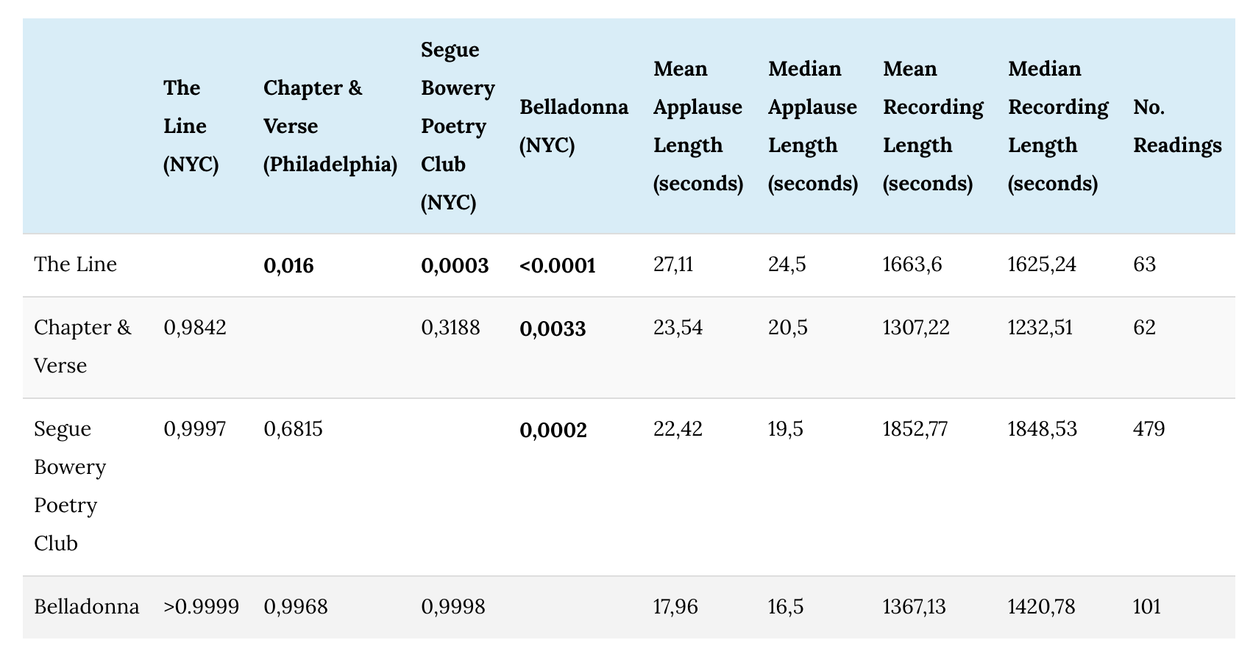
P values for Pairwise Directional Mann-Whitney U Tests Between Four Reading Series' Measured Applause Durations
Notes:
Comparing applause rates across these four collections, we see more significant differences than in our tests of individual author pairs. Interpreting results at the p<0.05 level as significant, we observe that

Slide 44
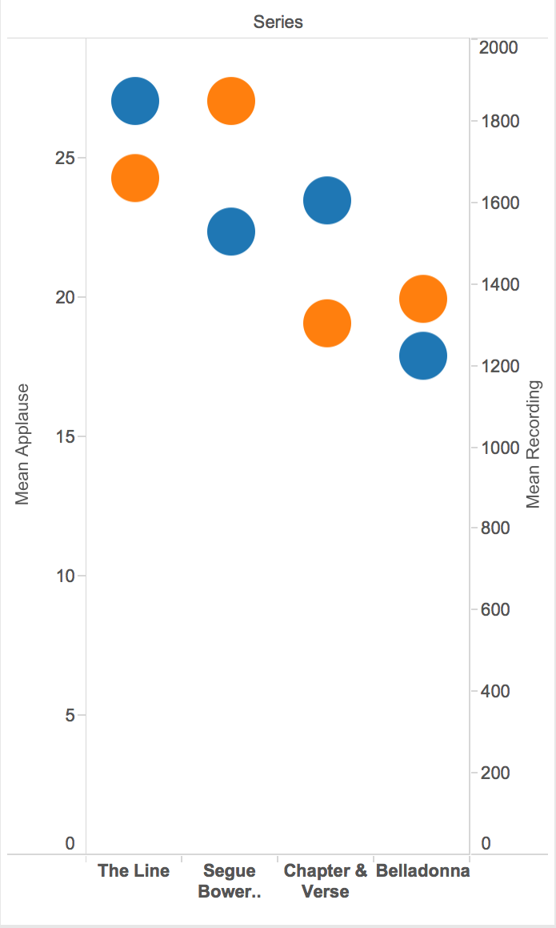
Applause by Reading Series
Blue: mean applause length
Orange: mean recording length

Slide 45
1. The Line (NYC): 2000 and 2004
curated by Lytle Shaw, a professor at New York University, and held at The Drawing Center in New York City
hosted well-established, widely acclaimed poets including Jackson Mac Low, Bernadette Mayer, Jennifer Moxley, and Christian Bök
primarily affiliated with the Language movement and experimental practices such as conceptual writing and Flarf.
Notes:
maintain particular tastes, conventions, and group temperaments that inform how a poem is shaped and understood and reshaped in that culture.

Slide 46
2. Chapter & Verse (Philadelphia): 2008-2012
includes poets living in Philadelphia (Linh Dinh, Emily Abendroth),
associated with poetics grad programs at the University of Pennsylvania and Temple University, the SUNY-Buffalo poetics program (Brian Teare, Sarah Dowling, Joey Yearous-Algozin, Kristen Gallagher).

Slide 47
3. Segue Bowery Poetry Club (NYC): 2002-2012
was held at the Bowery Poetry Club in New York's East Village.
founded by Ted Greenwald and Charles Bernstein as the Ear Inn Reading Series in 1978, it has been run by James Sherry's Segue Foundation since 1998,
with separate curators for fall, winter, and spring seasons.

Slide 48
4. Belladonna (NYC) 1999-today
run by a feminist avant-garde collective that also runs an independent press.
typically hosted at bookstores, festivals, and other performance venues (such as the Bowery Poetry Club)
readers for the series, almost all of them women, have included Language poets (Carla Harryman, Lyn Hejinian), younger Beat-affiliated writers (Anne Waldman, Leslie Scalapino), and descendants of the New York School tradition (Alice Notley, Erica Kaufman).
hosts poets who are both widely acclaimed and affiliated with universities alongside largely unknown artists.

Slide 49
Applause by Reading Series
Blue: mean applause length
Orange: mean recording length

Slide 50
"For me, as a Jew and as a woman, the very act of speaking out, the act of 'coming to voice' [bell hooks], is intrinsically a political one. One of the many ways of ensuring women's powerlessness has been the suppression of voice.”
Thorn, L. (1999). Poetic Dis/closure. In S. Wade and P. Munden (Eds.), Reading the Applause. York: Talking Shop.

Slide 51

Thank you!
Questions?
tclement@ischool.utexas.edu
Special thanks to Steve McLaughlin, David Tcheng, and Loretta Auvil, the National
Endowment for the Humanities, and
the School of Information at UT Austin

Slide 52
Using ARLO to read Sound
“What if there were a way . . . to locate other recordings from the CPS in PennSound, by using machine listening to conduct pattern recognition on the ubiquitous hiss in these recordings?”
Mustazza, C. “The noise is the content: Toward computationally determining
the provenance of poetry recordings using ARLO”. Jacket2. 10 Jan. 2015.

Slide 53
The Line: Language poets who create disjunctive poetry that relies on reader and audience participation in the meaning-making process.

Slide 54
Using ARLO to read Sound
“When audience members laugh in the midst of a poetry recording, they remind the listener that she is not listening to a monologic performance but to a dialogic exchange.”
Rettberg, E. “Hearing the Audience”. Jacket2. 26 March 2015.

Slide 55
Using ARLO to read Sound
“In particular, I wanted to compare variant recordings in terms of tempo, loudness, pitch range, tension, rhythm, and voice quality (to adopt widely accepted terms for paralinguistic features of speech) . . . I wanted to look at a group of known calls/poems and come to better understand their points of difference and correspondence.”
Sherwood, K. “Distanced sounding: ARLO as a tool for the analysis and visualization
of versioning phenomena within poetry audio” Jacket2. 2 March 2015.

Slide 56
Using ARLO to read Sound
“She employs line graphs of intonation patterns to demonstrate one version of the neutral style, termed monotonous incantation.”
MacArthur, M. "Monotony, the Churches of Poetry Reading, and Sound Studies."
PMLA. Forthcoming 2015.

Slide 57
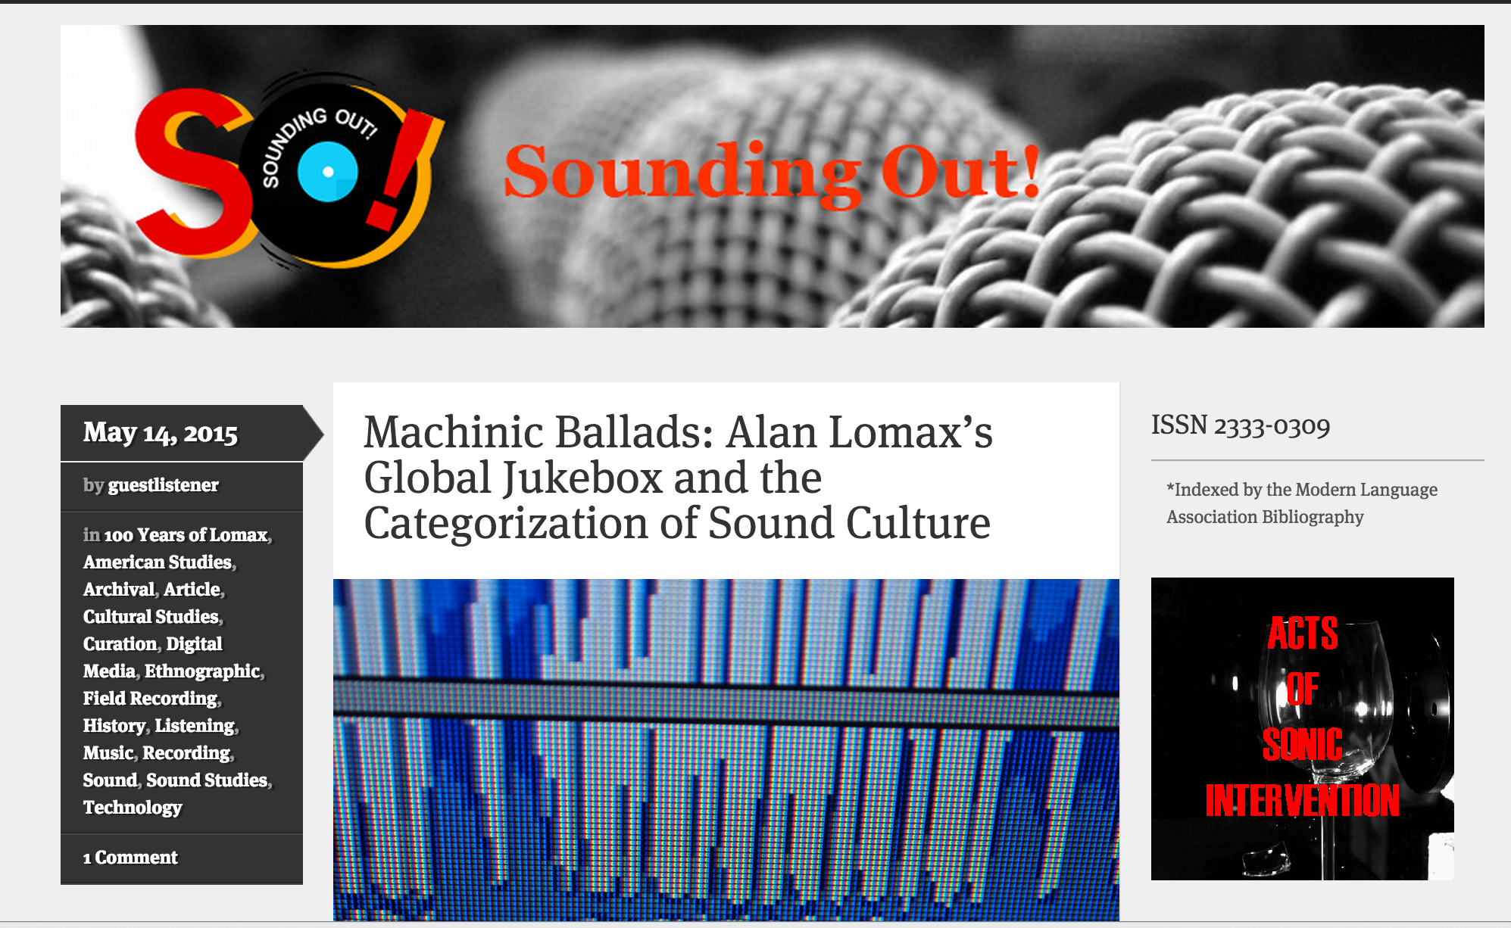
Publish
http://soundstudiesblog.com/

Slide 58
Sung, Instrumental, Spoken in Folklore
folklore at Briscoe Center for American History at UT Austin, 57 feet of tapes (reels and audiocassettes)
219 hours, 455 files;
4,000 two-second windows tagged for:
Instrument
Spoken
Sung
Notes:
has both kinetic (how fast) and potential energy -- add them up and get total energy for each band at a point of time; then sum them up into bins that are 1/32nd in size ]; standard very simple two-pole filter --

Slide 59
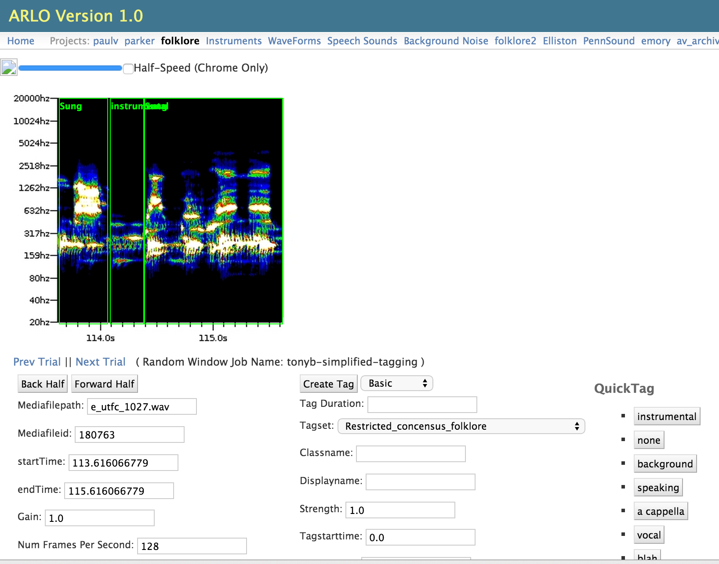
Three models: Sung, Instrumental, Spoken

Slide 60
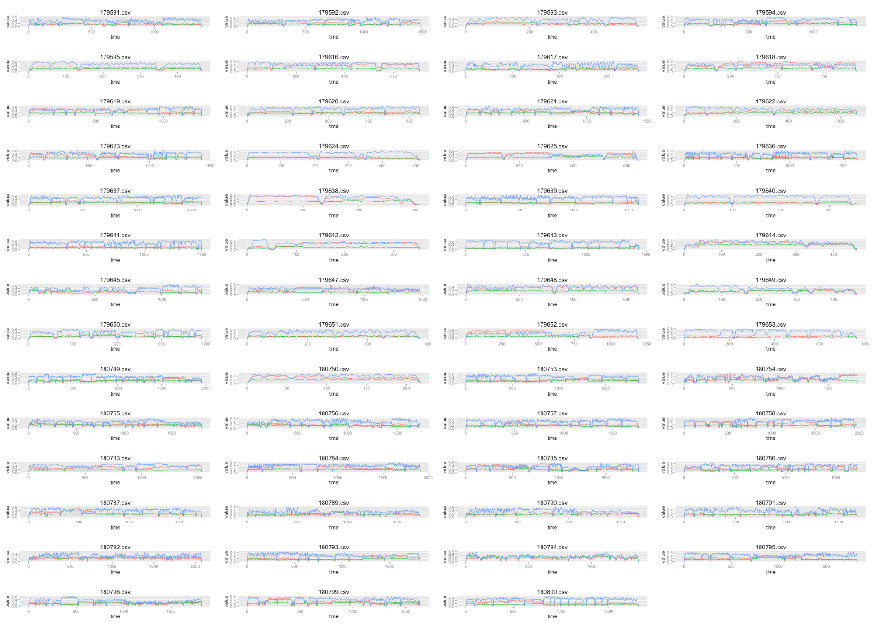
Applause in PennSound
55 John Alan Lomax recordings 1926-1941

Slide 61
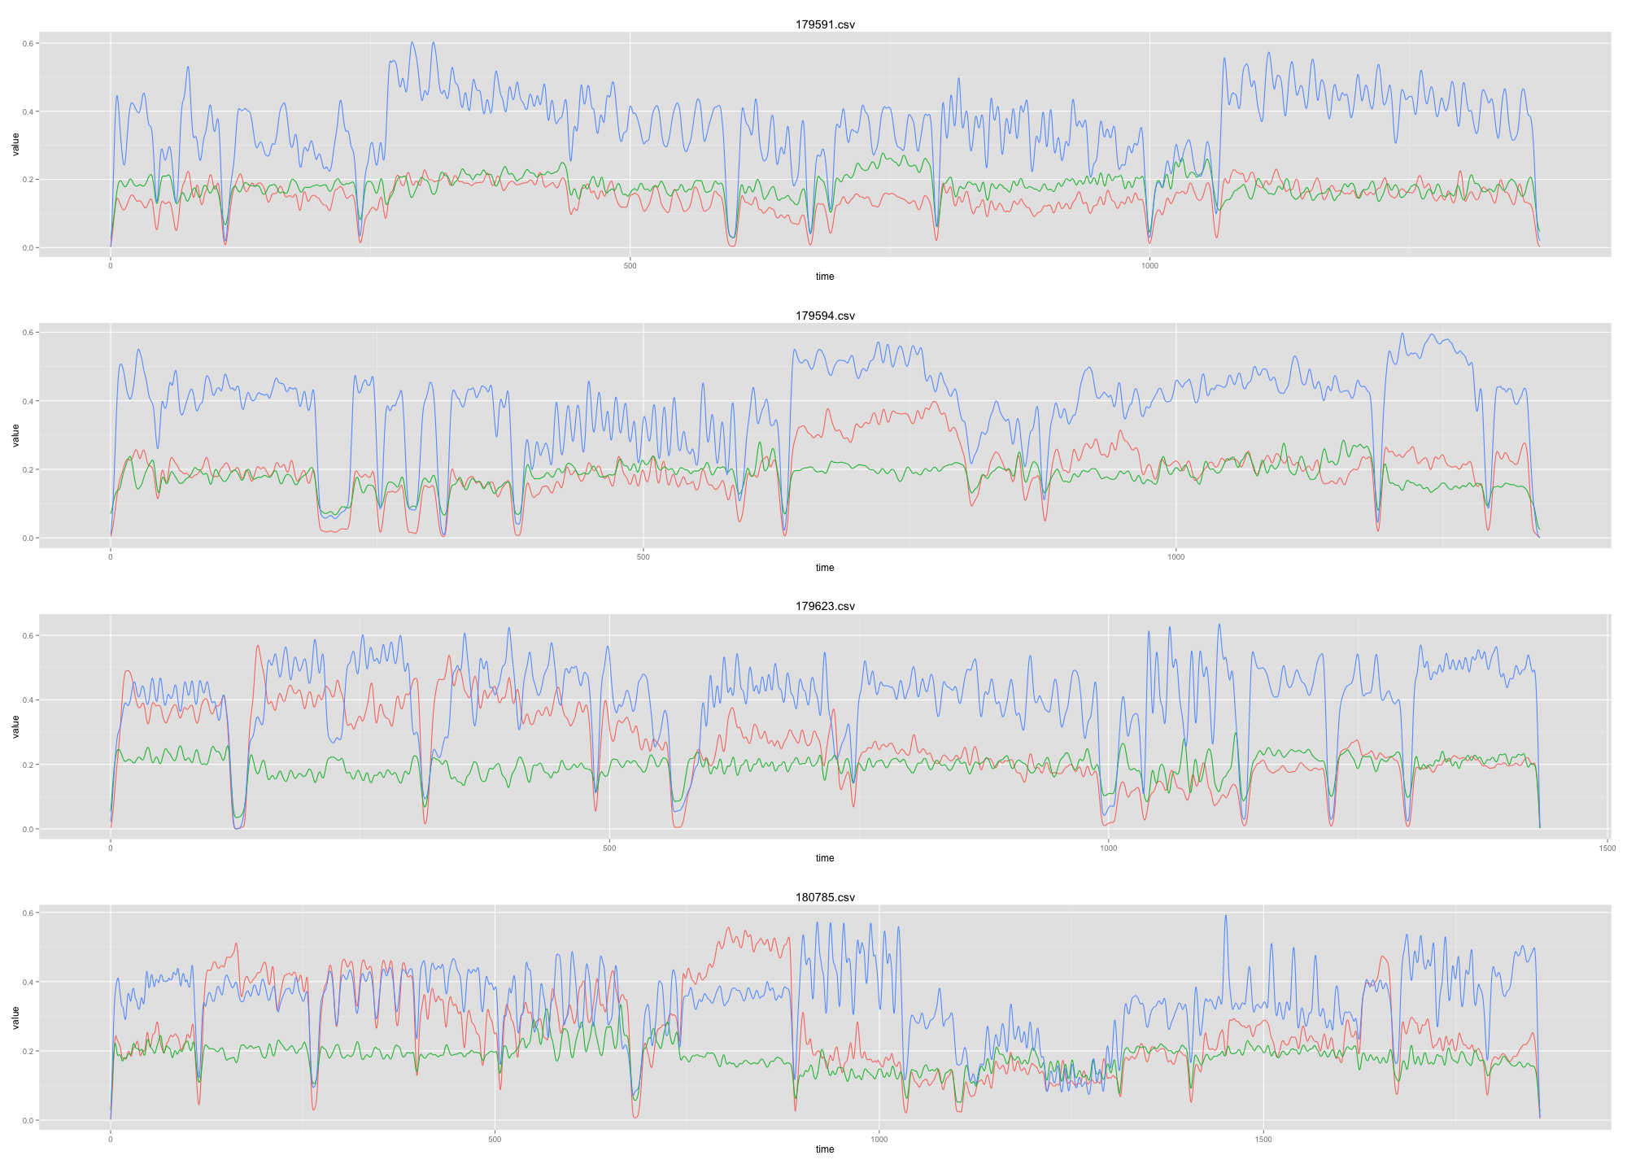
Blue = sung; green = spoken; red = instrumental
Notes:
Blue = sung; green = spoken; red = instrumental

Slide 62
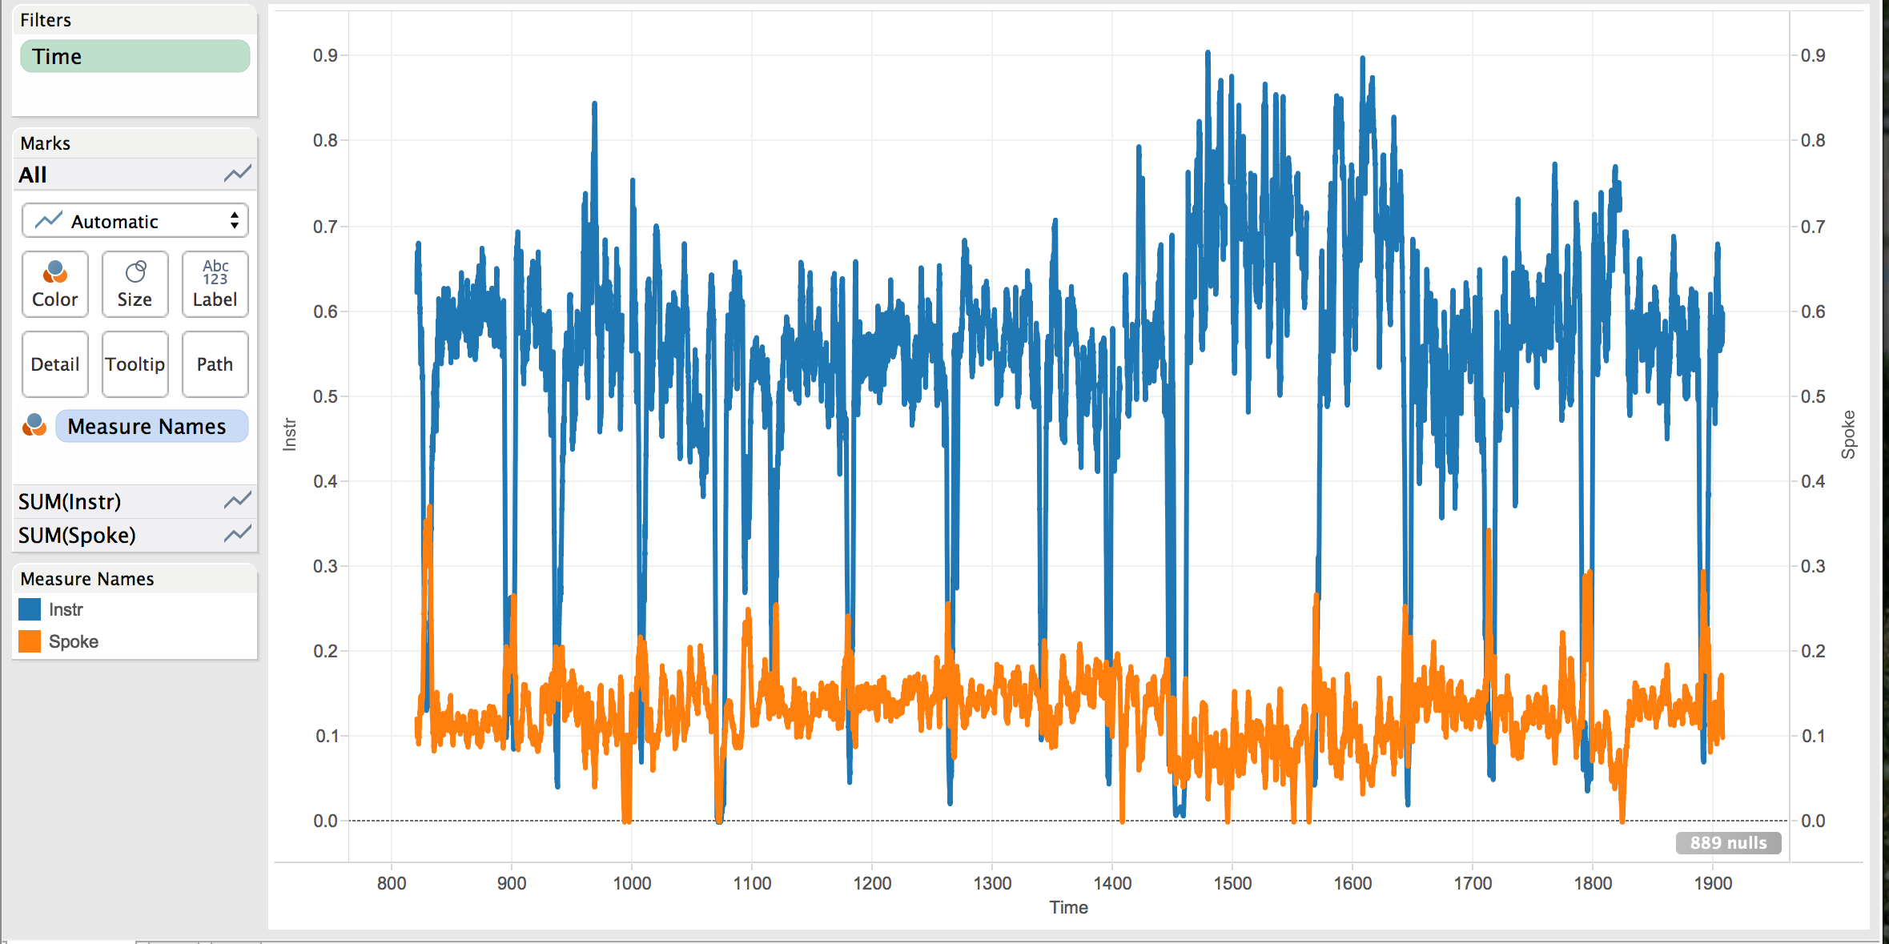

Slide 63
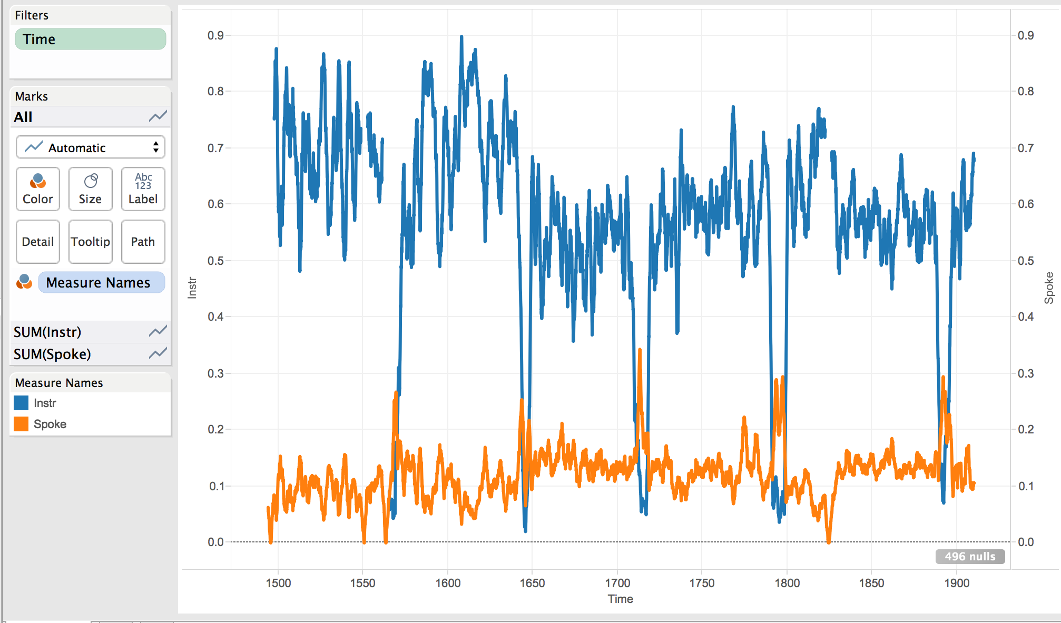

Slide 64
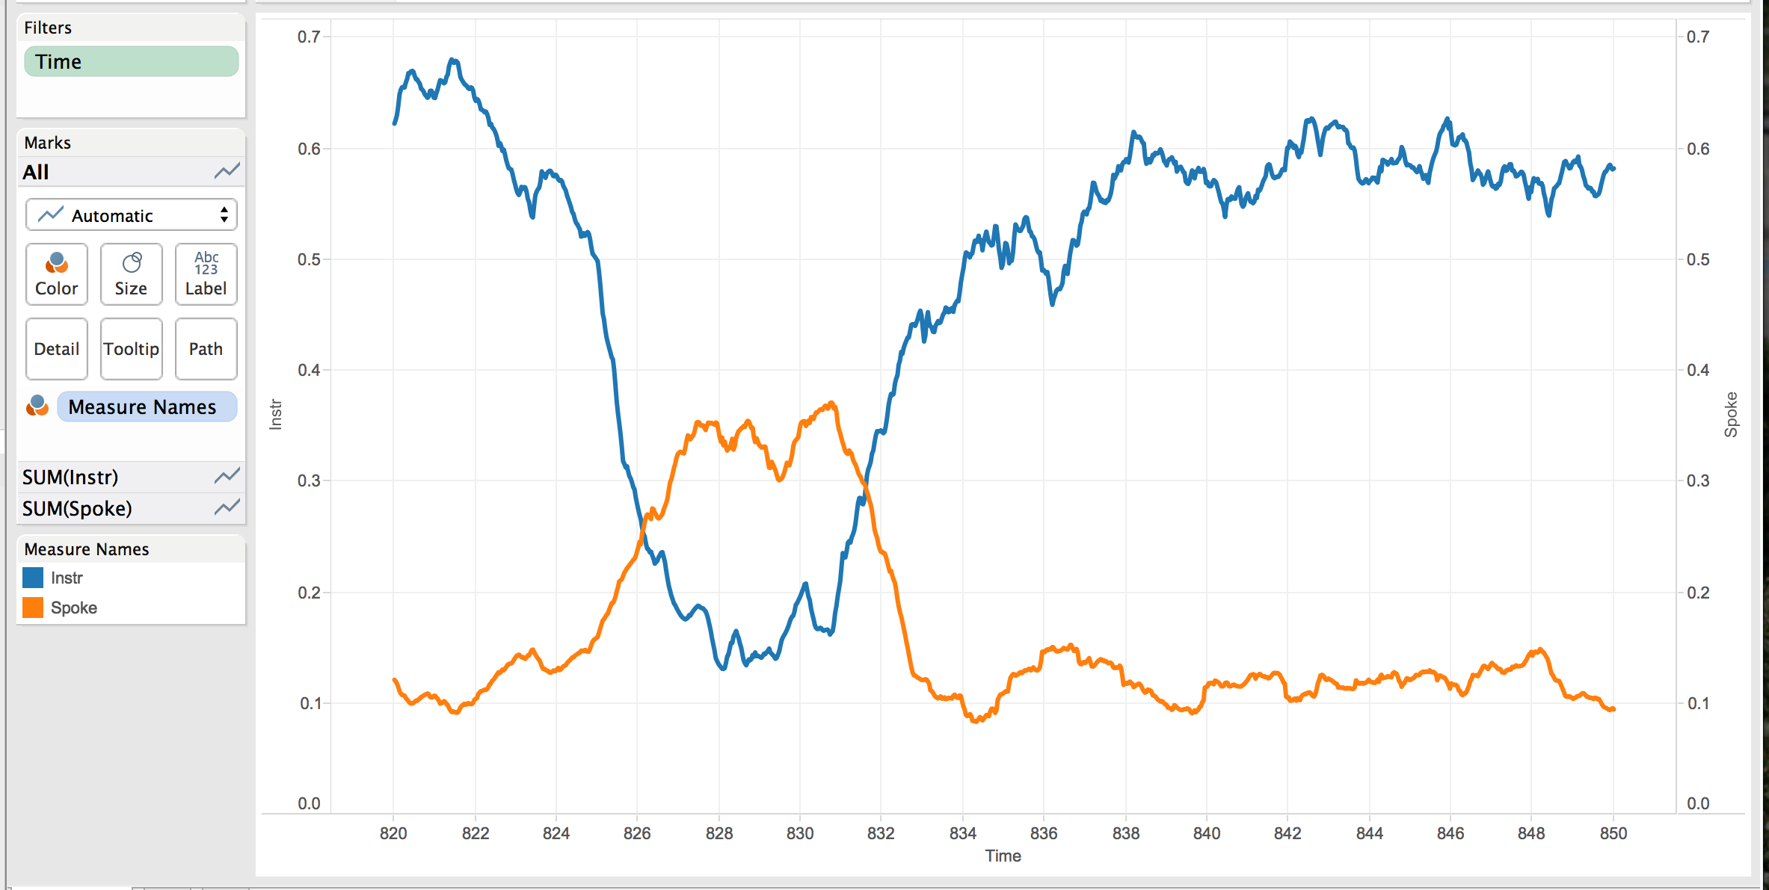
Notes:
Low voice between 820 and 845

Slide 65
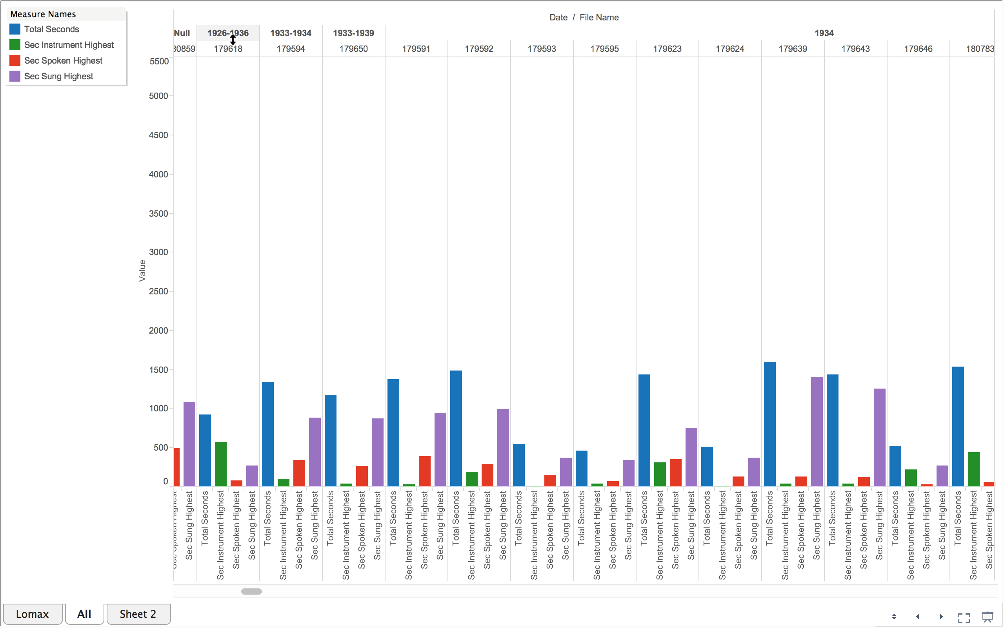
Applause in PennSound
Picture of time slices

